Slide 1
The Structural Simulation Toolkit (SST)
IPDPS 2025
Presented by: Scott Hemmert, Clay Hughes, Joe Kenny, Gwen Voskuilen, Sandia National Laboratories
Content by: SST Team
Milan, Italy
Tuesday, June 3
SAND2025-06737C

Slide 2
SST Tutorial – IPDPS 2025

Slide 3


Instructors
Gwen Voskuilen grvosku@sandia.gov
Scott Hemmert kshemme@sandia.gov
Clay Hughes chughes@sandia.gov
Joseph Kenny jpkenny@sandia.gov
Dave Donofrio ddonfrio@tactcomplabs.com
John Leidel jleidel@tactcomplabs.com

Slide 4
Welcome!
Part 1: Introduction to SST
SST overview – Why, What, How
Basic simulation workflow
A Tour of SST Elements
Break 15:30 – 16:00
Part 2: Full System Modeling with SST
Networks Applications

Slide 5

Learning Objectives – Part 1: Introduction to SST
This section of the tutorial will cover the following topics:
Why use SST?
What capabilities does SST provide?
How do I use SST?
The basic structure of the SST project
How to run a simulation in SST
How to view the statistics from your simulation
How to find information about components with sst-info
A summary of the many available components
Where to get more info and help

Slide 6
Codespaces
We will use Github Codespaces for this tutorial.
Everyone with a Github account receives 180 free core hours and 15 free gigabytes of storage every month.
https://github.com/sstsimulator/sst-tutorials
Click “Code”
”Codespaces”
“...”
“New with options”
Dev container configuration -> “ipdps2025_day1”
“Create codespace”
Alternate instructions are available at https://github.com/sstsimulator/sst-tutorials/tree/master/ipdps2025
You may also want to open https://github.com/sstsimulator/sst-elements in another tab

Slide 7
Container
The codespace automatically loads our container from Dockerhub
Includes SST, and the simulation components required for this tutorial
The codespace also includes you a copy of the sst-tutorials repository, so you can edit the files we will work on
Try it out: `sst`
We didn’t give it an input file so it can’t simulate anything yet!

Slide 8
References
Websites
Information on installing SST, and links to everything else you see here
http://www.sst-simulator.org/
Documentation on SST’s key interfaces, overview of all the elements, and more!
http://sst-simulator.org/sst-docs/
Code
https://github.com/sstsimulator
Important Pages
Configuration File Format: http://sst-simulator.org/sst-docs/docs/guides/configuration/pythonConfigGuide
Getting Started: http://sst-simulator.org/sst-docs/docs/guides/start
SST-Core Doxygen: http://sst-simulator.org/SSTDoxygen/15.0.0_docs/html/
Building SST
Quick start: http://sst-simulator.org/SSTPages/SSTBuildAndInstall_15dot0dot0_SeriesQuickStart/
Detailed: http://sst-simulator.org/SSTPages/SSTBuildAndInstall_15dot0dot0_SeriesDetailedBuildInstructions/

Slide 9
Part 1: Introduction to SST

Slide 10


Simulation appears in many contexts
Research Prototyping Validation
When hardware or software doesn’t exist yet
When hardware exists but is difficult to access or measure
Different fidelities
Different timescales
Different system scales
Related and sometimes intertwined problems
One ecosystem that can adapt to multiple needs and leverage community expertise
Reuse
Multi-fidelity
Modular

Slide 11
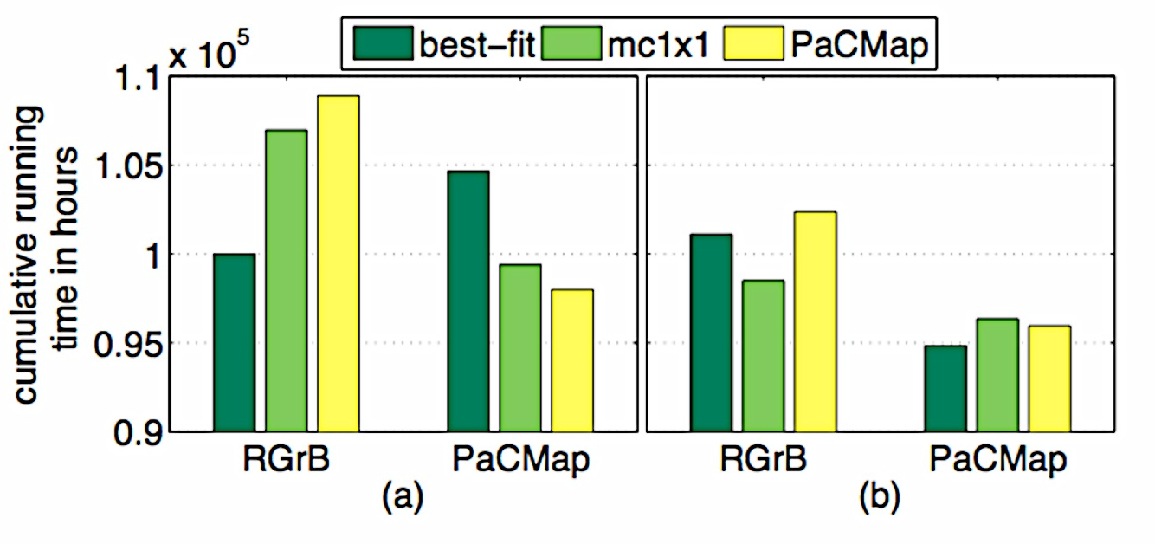



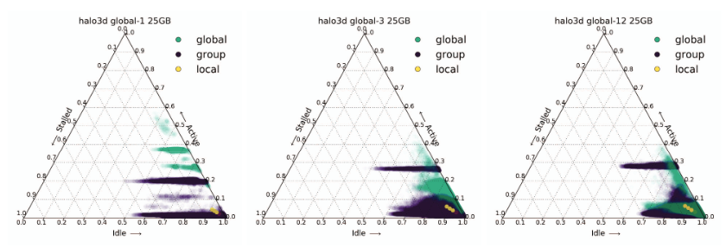

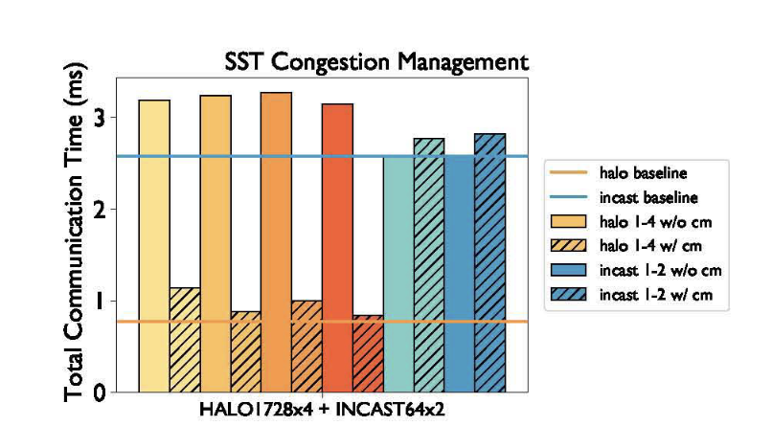
Simulation at many scales
Job scheduling algorithms to improve runtime and throughput
“PaCMap: Topology Mapping of Unstructured Communication Patterns onto Non-contiguous Allocations” Tuncer, Leung, Coskun. ICS, 2015.
Time
System size
Balancing power and performance in exascale networks
“(SAI) Stalled, Active and Idle: Characterizing Power and Performance of Large-scale Dragonfly Networks.” Groves, Grant, Hemmert, Hammond, Levenhagen, Arnold. IEEE Cluster, 2016.
Workload requirements for network congestion management
“Exploration of Congestion Control Techniques on Dragonfly-class HPC Networks Through Simulation.” McGlohon, Hemmert, Brown, Levenhagen, Chunduri, Ross, Carothers. PMBS Workshop. 2021.
On-chip network limits memory bandwidth
“HBM2/3 Evaluation on Many-Core CPU.” Voskuilen, Gimenez, Peng, Moore, Gokhale. Report, Exascale Compute Project. 2018.

Slide 12
SST Overview

Slide 13

Why SST?
There is a rich selection of open-source simulators
But not a solid ecosystem for modeling systems
Tightly-entangled components make modifications complex
E.g., assumptions about caching or address mapping are pervasive
Most simulator integrations are ad-hoc, not lasting
Significant performance problems with tying many simulators together
Wants:
Enable “mix-and-match” of existing models to create custom systems
Encourage disentangled models with clean interfaces for swapping functionality
Bricks not buildings
Low effort, high performance parallel simulation
Continuous path from low-fidelity/fast modeling to high-fidelity/slow models

Slide 14



The Structural Simulation Toolkit
Goals
Create a standard architectural simulation framework for HPC*
Ability to evaluate future systems on current and emerging workloads
Use supercomputers to design supercomputers
Status
Parallel framework (SST Core)
Integrated libraries of components (Elements)
Current Release (15.0.0)
Two releases per year
Consortium
“Best of Breed” simulation suite
Used in industry, academia, and at labs
Technical Approach
Parallel Discrete Event core
With conservative optimization over MPI/Threads
Interoperability
Node and system-scale models
Multi-scale
Detailed (~cycle) and simple models that interoperate
Open
Open Core, non-viral, modular
Notes:
Chang epicture

Slide 15
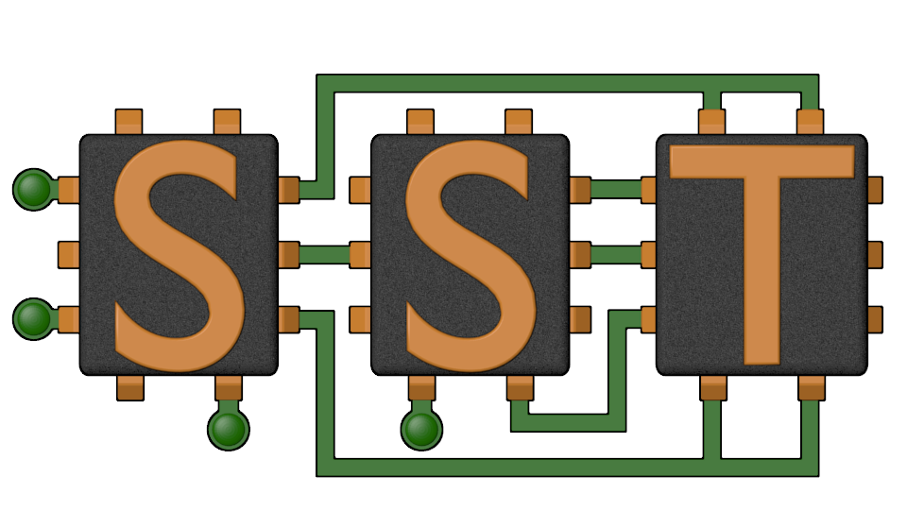
The SST Approach
Parallel Discrete-Event Simulator Framework (SST Core)
Flexible framework enables multitude of custom “simulators”
Demonstrated scaling to over 512 processors running a million+ components
Comes with many built-in simulation models (SST Elements)
Processors, memories, networks
Open API
Easily extensible with new models
Modular framework
Open-source core
Time-scale independent core
Handles Micro-, Meso-, Macro-scale simulations
C++, Python

Slide 16
SST Architecture
SST Core framework
The backbone of simulation
Provides utilities and interfaces for simulation components (models)
Clocks, event exchange, statistics and parameter management, parallelism support, etc.
SST Element libraries
Models that perform the actual simulation
Elements include processors, memory, network, etc.
Leverages many existing simulators: Spike, DRAMSim3, Ramulator2, etc.
Component
Component
Component
Component
Processor
Cache
DRAM
NoC
Integration Services
Links, Clocks, etc.
SST Core
SST Core
MPI and C++ Threads
MPI and C++ Threads

Slide 17
Building Blocks: 101
In SST, systems are described as a set of components
Components are connected by links
Components communicate by sending events over the links
When creating models for SST, developers map their models to this structure.
When running models in SST, the user maps their desired system to this structure and tells SST which components to use and how they are linked.
Component
Core
Component
Core
Event
Load
Link
Link
Component
Cache
Component
Cache
Event
Data
Link
Link
Component
NoC Router
Component
NoC Router
Link
Element Library
A collection of components (and other SST building blocks)

Slide 18
Building Blocks: Restrictions
Developers:
Components may only communicate with other components via events
Users:
Every event sent between components incurs a latency
The latency cannot be zero and the minimum latency is set by the user

Slide 19
Building Blocks: 201
SubComponents and Modules allow users to swap in different functionality within a Component.
SubComponents are larger and might participate in event exchange
E.g., a prefetcher
Modules are smaller, with very limited access to simulation APIs
E.g., a hash function
Standardized interfaces for certain types of components makes swapping components simpler
Endpoint / Network: SimpleNetwork
Processor / Memory: StandardMem
Component
Core
Component
Core
Event
Load
Link
Link
Component
Cache
Component
Cache
Event
Data
SubComponent
Prefetcher
Link
Link
Component
NoC Router
Component
NoC Router
Link

Slide 20

SST Code Structure
SST Core and SST Elements are compiled separately
Element libraries register with the core
External elements (not part of SST Elements) can also be registered with the core
Example at github.com/sstsimulator/sst-external-element
Core maintains a database of registered libraries
Can query database with sst-info utility
Source code for core:
sst-core/src/sst/core/
Source code for elements
sst-elements/src/sst/elements/
Most elements have a tests/ directory
sst-elements/src/sst/elements/SomeComponent/tests
Often a good starting point for basic configurations
Component
Component
Component
Component
Integration Services
SST Core
MPI and C++ Threads

Slide 21
Basic SST Simulation

Slide 22
Simulation in just 3 steps… ☺
Define the system you want to simulate
Run SST
Analyze output

Slide 23
SST input files describe the graph of the system to be simulated
The input file describes:
The components that make up the simulation (vertices) including their parameters
The links between the components and their latencies (edges)
It also may:
Define any global options that control the simulation as a whole
Declare which statistics to collect and how to report them
Typically written in Python
JSON also supported
gen
core
cache
memctrl
mem

Slide 24
Our First Simulation – demo_1.py
Simulated System
We’ll walk through how to configure a simulation and then run it
Location: sst-tutorials → ipdps2025 → exercises → single-node
gen
core
cache
memory
memctrl
These names match the variables in demo_1.py

Slide 25
Our First Simulation – demo_1.py
Simulated System
Element libraries in our example simulation
Miranda - Simple core model that runs generated instruction streams
Generators produce memory access patterns (SubComponent)
memHierarchy – Various cache/memory system related subcomponents and modules
Cache (Component) with coherence protocol SubComponent
Memory Controller (Component) that loads a memory timing model (SubComponent)
gen
core
cache
memory
memctrl
These names match the variables in demo_1.py

Slide 26
Configuration File: Global SST parameters
Set any global simulation parameters
Other options
Most command line options to SST can also be set using setProgramOption()
import sst
##########################
## Define SST core options
##########################
# If this demo gets to 100ms, something # has gone very wrong!
sst.setProgramOption("stop-at", "100ms")
SST Python API
User-defined string
SST argument
Option | Definition
debug-file | File to print debug output to
heartbeat-period | If set, SST will print a heartbeat message at the specified period
print-timing-info | Tells SST to print timing information from the run
partitioner | Partitioner to use for parallel execution
output-partition | File to print partition to
Notes:
line 7

Slide 27
Configuration File: Declare components
SST Python API
User-defined string
SST argument
Components: sst.Component(“name”, “type”)
gen
######################
## Declare components
######################
core = sst.Component(“core”, “miranda.BaseCPU”)
cache = sst.Component(“cache”, “memHierarchy.Cache”)
memctrl = sst.Component(“memory”, “memHierarchy.MemController”)
core
cache
memctrl
mem
Component name
Element library
Notes:
line 13-15

Slide 28

Configuration File: Configure the core
SST Python API
User-defined string
SST argument
Parameters: addParams({ “parameter” : “value”, … })
########################################################
## Set component parameters and fill subcomponent slots
########################################################
core.addParams({
"clock" : "2.4GHz",
"max_reqs_cycle" : 2,
})
gen
core
cache
memctrl
mem
How do I know what the options are? Or even what elements I can pick from?
sst-info
Notes:
line 22

Slide 29
Aside: sst-info
Use sst-info to find information about all registered elements.
$ sst-info miranda.baseCPU
PROCESSED 1 .so (SST ELEMENT) FILES FOUND IN DIRECTORY(s) [...]
================================================================================
ELEMENT LIBRARY 0 = miranda ()
Components (1 total)
Component 0: BaseCPU
Description: Creates a base Miranda CPU ready to execute an address generator/access pattern
ELI version: 0.9.0
Compiled on: Dec 1 2023 14:33:14, using file: mirandaCPU.h
Category: PROCESSOR COMPONENT
Parameters (12 total)
max_reqs_cycle: Maximum number of requests the CPU can issue per cycle (this is for all reads and writes) [2] ...

Slide 30
Configuration File: Add a subcomponent
SST Python API
User-defined string
SST argument
SubComponents: setSubComponent(“slotname”, “type”)
Recall: SubComponent is a swappable piece of functionality
gen
gen = core.setSubComponent("generator", "miranda.STREAMBenchGenerator")
gen.addParams({
"n" : 1000, # Number of array elements
})
core
cache
memctrl
mem
Notes:
line 26

Slide 31
Configuration File: Configure the cache
SST Python API
User-defined string
SST argument
cache.addParams({
"L1" : 1,
"cache_frequency" : "2.4GHz",
"access_latency_cycles" : 2,
"cache_size" : "2KiB",
"associativity" : 4,
"replacement_policy" : "lru",
"coherence_policy" : "MESI",
"cache_line_size" : 64,
})
gen
core
cache
memctrl
mem
Notes:
line 32-41

Slide 32
Configuration File: Configure the memory controller
SST Python API
User-defined string
SST argument
memctrl.addParams({
"clock" : "1GHz",
"backing" : "none", # No real memory values, just addresses
"addr_range_end" : 1024*1024*1024-1,
})
memory = memctrl.setSubComponent("backend", "memHierarchy.simpleMem")
memory.addParams({
"mem_size" : "1GiB",
"access_time" : "50ns",
})
gen
core
cache
memctrl
mem
Notes:
line 44-53

Slide 33
Configuration File: Declare and connect
Links: sst.Link(“name”)
#######################################
## Declare links
#######################################
core_cache = sst.Link("core_to_cache")
cache_mem = sst.Link("cache_to_memory")
########################################
## Connect components with the links
########################################
core_cache.connect( (core, "cache_link", "100ps"), (cache, "highlink", "100ps") )
cache_mem.connect( (cache, "lowlink", "100ps"), (memctrl, ”highlink", "100ps") )
gen
core
Link name
cache
memctrl
mem
Notes:
Line 59-67

Slide 34
Configuration File: Connect links
Connect components: connect(endpoint1, endpoint2)
Where endpoint is: (component, port, latency)
gen
########################################
## Connect components with the links
########################################
core_cache.connect( (core, "cache_link", "100ps"), (cache, ”highlink", "100ps") )
cache_mem.connect( (cache, "lowlink", "100ps"), (memctrl, ”highlink", "100ps") )
core
Endpoint 1
cache
Endpoint 2
memctrl
mem
How do I remember the port names?

Slide 35
SSTInfo: Getting component info
sst-info: utility to query element libraries
Optionally filter for a specific library and/or component
$ sst-info memHierarchy.Cache
PROCESSED 1 .so (SST ELEMENT) FILES FOUND IN DIRECTORY(s) /home/sst/build/lib/sst
Filtering output on Element = “memHierarchy.Cache”
================================================================================
ELEMENT LIBRARY 0 = memHierarchy ()
Components (15 total)
Component 0: Cache
Description: Cache controller
…
Parameters (34 total)
cache_frequency: (string) Clock frequency or period with units (Hz or s; SI units OK) [<required>]
cache_line_size: (uint) Size of a cache line (aka cache block) in bytes. [64]
…
Ports (12 total)
highlink: Non-network upper/processor-side link (i.e., link towards the core/accelerator/etc.).
…
Statistics (48 total)
TotalEventsReceived: Total number of events received, (units = "events") Enable level = 1
…
“REQUIRED” or default value
Parameter
Definition
Port name
Definition
Name
Definition
Units
Enable Level

Slide 36
Running SST
Usage: sst [options] configFile.py
Common options:
-h | --help | Print complete list of command line options
-v | --verbose | Print information about core runtime
--debug-file <filename> | Send debugging output to specified file (default: sst_output)
--partitioner <self | simple | rrobin | linear | lib.partitioner_name> | Specify the partitioning mechanism for parallel runs
-n | --num_threads <num> | Specify number of threads per rank
--model-options “<args>” | Command line arguments to send to the Python configuration file. Any arguments after a final – will be appended to the model-options.
--output-partition <filename> | Write partitioning information to <filename>
--output-dot <filename> --output-xml <filename> --output-json <filename> | Output the configuration graph in various formats to <filename>
Notes:
Is this still up to date?

Slide 37
Running a simulation
Launch simulation
Output
We probably want more information about what happened though
Enable statistics!
$ sst demo_1.py
Simulation is complete, simulated time: 6.80711 us

Slide 38
Enabling statistics
Most Components and SubComponents define statistics
The input file declare which statistics to report (enable)
enableAllStatisticsForAllComponents()
enableAllStatisticsForComponentType(type)
enableAllStatisticsForComponentName(name)
setStatisticLoadLevel(level)
…and how to report them
setStatisticOutput(“sst.output_type”)
setStatisticOutputOptions({“option” : “value”, })
$ sst-info memHierarchy.Cache
…
Statistics (48 total)
TotalEventsReceived: Total number of events received, (units = "events") Enable level = 1
CacheHits: Total number of cache hits, (units = count) Enable Level = 1
latency_GetS_hit: Latency for read hits, (units = cycles) Enable level = 1
enableStatisticForComponentName(name, stat)
enableStatisticForComponentType(type, stat)

Slide 39
Running with statistics enabled
Let’s enable statistics for all components
Caches have A LOT of statistics so send the output to a CSV file
Other options: sst.statoutputX where X=
console
json
txt
hdf5
sst.setStatisticOutput(“sst.statoutputcsv”)
sst.setStatisticOutputOptions({ “filepath” : “stats.csv” })
sst.setStatisticLoadLevel(5)
sst.enableAllStatisticsForAllComponents()

Slide 40
Running a Simulation – Add Statistics
Copy configuration
Add statistics to new configuration
Launch simulation
Take a minute to look at the statistics
Can you calculate the L1 memory bandwidth?
$ cp demo_1.py demo_2.py
What should you add?
$ sst demo_2.py

Slide 41
SST in parallel
MPI Rank 0
Comp0
Comp2
Comp4
Comp6
SST was designed from the ground up to enable
scalable, parallel simulations
Components distributed among MPI ranks/threads
Link latency controls synchronization rate
Sadly, MPI is not supported in our container
Comp1
Comp3
Comp5
Comp7
# Two ranks
$ mpirun –np 2 sst demo_1.py
# Two threads
$ sst –n 2 demo_1.py
# Two ranks with two threads each
# This will give a warning since we only
# have 3 components across 4 ranks/threads
$ mpirun –np 2 sst –n 2 demo_1.py
Same configuration file
MPI Rank 0
MPI Rank 1
MPI Rank 2
MPI Rank 3
Comp0
Comp2
Comp4
Comp6
Comp1
Comp3
Comp5
Comp7
Notes:
Links handle serialization

Slide 42
A Tour of SST Elements

Slide 43

SST Element Libraries
Elements are libraries of related components
Elements must be registered with the SST core
Tells SST where to find this set of components
Includes information on parameters and statistics for each component
SST provides a set of element libraries
Processor, network, memory, etc.
Tested for interoperability within and across libraries
Many are compatible with external “components” such as Ramulator and Spike
You can also register your own elements
Example: https://github.com/sstsimulator/sst-external-element

Slide 44
(A few) SST 15.0 Elements
Processors
Ariel – PIN-based
Prospero – trace execution
Miranda – pattern generator
Vanadis – MIPS32 and RV64 pipeline
Memory Subsystem
MemHierarchy – caches, directory, memory
Network drivers
Ember – communication patterns
Firefly – communication protocols
Hermes – MPI-like driver interface
Mercury – Application skeletons
Networks/NoCs
Merlin – flexible network modeling
Kingsley – mesh NoC

Slide 45
Processor Models
Elements:
Ariel
Prospero
Miranda
Vanadis

Slide 46
Ariel: PIN-based processor
$ sst-info ariel.ariel
Lightweight processor core model
Uses Intel’s PIN tools and XED decoders to analyze binaries
Runs x86, x86-64, SSE/AVX, etc. binaries
Supports fixed thread count parallelism (OpenMP, Qthreads, etc.)
Passes instructions to virtual core in SST
Pin
x86 Binary
Binary
Instruction
trace
Ariel CPU
SST
Core
Core
Core
Core
Processor
Memory
Network/NoC
Network driver
Other

Slide 47
Ariel: Details
$ sst-info ariel.ariel
Pintool communicates with Ariel via shared memory IPC
Per-thread FIFO of instructions from pintool to Ariel’s virtual cores
Backpressure on FIFO halts the binary’s execution
Ariel’s virtual cores
Memory instruction oriented: execute memory instructions; other ins. single cycle no-ops
Clocked: Reads instruction stream in chunks but processes on clock
Does not maintain dependence order or register locations
Can map virtual-to-physical addresses internally or use external component
Key parameters
Ops issued/cycle
Load/store queue size
Uses SST standardMem interface
Generates StandardMemRequests
Compatible with memHierarchy
Processor
Memory
Network/NoC
Network driver
Other

Slide 48
Ariel: The Tradeoff
$ sst-info ariel.ariel
Pros:
Faster than more complex/pipeline models
Reasonable approximation for studies on memory system performance
Especially for heavily memory-bound applications
Reasonable model of thread interactions
Cons
Non-deterministic results
Interactions between pintool, threads, etc.
Variation is low (O(1%))
Not compatible with non-x86 binaries
Reliant on Pin
Ongoing work to enable other frontends
Processor
Memory
Network/NoC
Network driver
Other

Slide 49
Prospero: Trace-based processor
$ sst-info prospero.prosperoCPU
Trace-based processor model
Like Ariel, memory instruction oriented
Reads memory ops from a file and passes to the simulated memory system
“Single core” but can use multiple trace files to emulate threaded or MPI applications
Supports arbitrary length reads to account for variable vector widths
Performs “first touch” virtual to physical mapping
Comes with Prospero Trace Tool to generate traces
Or can generate your own and translate to Prospero’s format
Processor
Memory
Network/NoC
Network driver
Other

Slide 50
Prospero: The Tradeoff
$ sst-info prospero.prosperoCPU
Pros
Faster than Ariel*
Provided you can get a trace
Cons
Traces can be very large
Requires good I/O system to store and read the trace
Traces are less flexible than actual execution
Capture a single execution stream using a single application input
Processor
Memory
Network/NoC
Network driver
Other

Slide 51
Miranda: Pattern-based processor
$ sst-info miranda.BaseCPU
Extremely light-weight processor model
Generates memory address patterns
Supports request dependencies
Library patterns
Strided accesses (single stream)
Forward and reverse strides
Random accesses
GUPS
STREAM benchmark
In-order & out-of-order CPU
3D stencil
Sparse matrix vector multiply (SpMV)
Copy (~array copy)
Stake interface to the Spike RiscV simulator
Ongoing work to integrate Spatter patterns
Processor
Memory
Network/NoC
Network driver
Other

Slide 52
Miranda: The tradeoffs
$ sst-info miranda.BaseCPU
Pros
Very lightweight – no binary, no trace
Good for applications whose address patterns are predictable
e.g., not much pointer-chasing
Models instruction dependences
Cons
Need a generator for the memory pattern of interest
Requires a good understanding of the pattern
Processor
Memory
Network/NoC
Network driver
Other

Slide 53

Vanadis: OOO Processor
$ sst-info vanadis.VanadisNodeOS
MPIS32 and RV64 compatible processor model
OOO model
Configure micro-architectural details
Instruction fetch/decode/retire rate
ROB size
Branch prediction
Multi-threaded cores
Musl libc used to cross-compile programs
Also tested with clang
System-call emulation
GPGPU-Sim Integration
Processor
Memory
Network/NoC
Network driver
Other

Slide 54
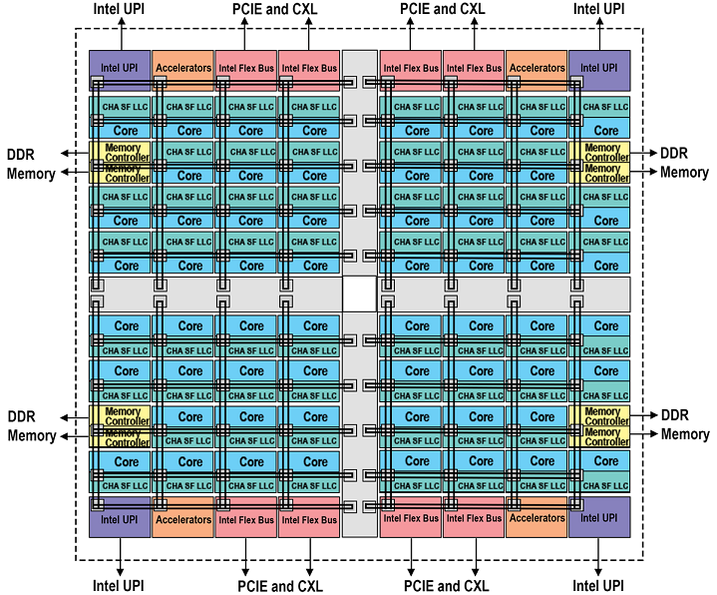
SOCs
What if you wanted something much more complex? Can SST simulate a core with SMT? What about something like a modern processor? SPR? EPYC?
https://www.intel.com/content/www/us/en/developer/articles/technical/fourth-generation-xeon-scalable-family-overview.html
https://www.amd.com/content/dam/amd/en/documents/epyc-technical-docs/white-papers/58015-epyc-9004-tg-architecture-overview.pdf

Slide 55
Single-core Vanadis
Let’s start simple…
RISC-V core
I-Cache
D-Cache
L2 Cache
Memory

Slide 56
Single-core Vanadis
What attributes can we change in the core model?
$ sst-info vanadis
Parameters (35 total)
verbose: Set the level of output verbosity, 0 is no output, higher is more output [0]
dbg_mask: Mask for output. Default is to not mask anything out (0) and defer to 'verbose'. [0]
start_verbose_when_issue_address: Set verbose to 0 until the specified instruction address is issued, then set to 'verbose' parameter []
stop_verbose_when_retire_address: When the specified instruction address is retired, set verbose to 0 []
pause_when_retire_address: If specified, the simulation will stop when this address is retired. [0]
pipeline_trace_file: If specified, a trace of the pipeline activity will be generated to this file. []
max_cycle: Maximum number of cycles to execute. The core will halt after this many cycles. [std::numeric_limits<uint64_t>::max()]
node_id: Identifier for the node this core belongs to. Each node in the system needs a unique ID between 0 and (number of nodes) - 1. Used to tag output. [0]
core_id: Identifier for this core. Each core in the system needs a unique ID between 0 and (number of cores) - 1. [<required>]
hardware_threads: Number of hardware threads in this core [1]
clock: Core clock frequency [1GHz]
reorder_slots: Number of slots in the reorder buffer [64]
physical_integer_registers: Number of physical integer registers per hardware thread [128]
physical_fp_registers: Number of physical floating point registers per hardware thread [128]
integer_arith_units: Number of integer arithemetic units [2]
integer_arith_cycles: Cycles per instruction for integer arithmetic [2]
integer_div_units: Number of integer division units [1]
integer_div_cycles: Cycles per instruction for integer division [4]
fp_arith_units: Number of floating point arithmetic units [2]
fp_arith_cycles: Cycles per floating point arithmetic [8]
fp_div_units: Number of floating point division units [1]
fp_div_cycles: Cycles per floating point division [80]
branch_units: Number of branch units [1]
branch_unit_cycles: Cycles per branch [int_arith_cycles]
issues_per_cycle: Number of instruction issues per cycle [2]
fetches_per_cycle: Number of instruction fetches per cycle [2]
retires_per_cycle: Number of instruction retires per cycle [2]
decodes_per_cycle: Number of instruction decodes per cycle [2]
dcache_line_width: Width of a line for the data cache, in bytes. (Currently not used but may be in the future). [64]
icache_line_width: Width of a line for the instruction cache, in bytes [64]
print_retire_tables: Print registers during retirement step (default is yes) [true]
print_issue_tables: Print registers during issue step (default is yes) [true]
print_int_reg: Print integer registers true/false, auto set to true if verbose > 16 [false]
print_fp_reg: Print floating-point registers true/false, auto set to true if verbose > 16 [false]
print_rob: Print reorder buffer state during issue and retire [true]

Slide 57
Single-core Vanadis
What attributes can we change in the core model?
$ sst-info vanadis
Default Parameter
Parameters (Purged a Few…)
clock: Core clock frequency [1GHz]
reorder_slots: Number of slots in the reorder buffer [64]
physical_integer_registers: Number of physical integer registers per hardware thread [128]
physical_fp_registers: Number of physical floating point registers per hardware thread [128]
integer_arith_units: Number of integer arithemetic units [2]
integer_arith_cycles: Cycles per instruction for integer arithmetic [2]
integer_div_units: Number of integer division units [1]
integer_div_cycles: Cycles per instruction for integer division [4]
fp_arith_units: Number of floating point arithmetic units [2]
fp_arith_cycles: Cycles per floating point arithmetic [8]
fp_div_units: Number of floating point division units [1]
fp_div_cycles: Cycles per floating point division [80]
branch_units: Number of branch units [1]
branch_unit_cycles: Cycles per branch [int_arith_cycles]
issues_per_cycle: Number of instruction issues per cycle [2]
fetches_per_cycle: Number of instruction fetches per cycle [2]
retires_per_cycle: Number of instruction retires per cycle [2]
decodes_per_cycle: Number of instruction decodes per cycle [2]

Slide 58
Single-core Vanadis
Let’s start simple…
Ok, not so simple but the structure is similar to all SST configurations
$ cat basic_vanadis.py
$ sst no_rtr_vanadis.py

Slide 59
Multi-core Vanadis
What if we want to make something more complex?
3x2 mesh
CPUs at 1, 3, 4, 5
Memory at 0, 2

Slide 60
Multi-core Vanadis
What if we want to make something more complex?
This looks frightening but isn’t that bad…
$ cat boom_vanadis-kingsley.py
$ sst boom_vanadis-kingsley.py

Slide 61
Vanadis: The tradeoffs
$ sst-info vanadis.VanadisNodeOS
Pros
Runs binaries
Detailed model of instruction dependencies
Cons
Slower than other models
Processor
Memory
Network/NoC
Network driver
Other

Slide 62
Memory
Elements:
memHierarchy

Slide 63
MemHierarchy: Memory system
$ sst-info memHierarchy | grep " Component"
Collection of interoperable memory system elements
Caches
Directories
Memory controllers
Interfaces to memory models (DDR, HBM, HMC, NVM, etc.)
Scratchpads
NoC (network-on-chip) interfaces
Buses
Components are cycle-accurate/cycle-level
Capable of modeling modern cache and memory subsystems
Memory
Processor
Network/NoC
Network driver
Other

Slide 64
MemHierarchy: Cache modeling
$ sst-info memHierarchy.Cache
Highly configurable
Arbitrary hierarchy depth, flexible topologies
Cache inclusivity, coherence, private/shared, etc. configurable
Single- and multi-socket configurations
Prefetch via Cassini element library
Data movement
Components support direct, bus, and on-chip network (NoC) communication
Event types: read/write, atomics, LLSC, noncacheable, custom memory, etc.
Memory
Processor
Network/NoC
Network driver
Other

Slide 65
MemHierarchy: Memory modeling
$ sst-info memHierarchy.MemController
Interface to memory is the MemController
MemControllers implement backends
These do the actual work of timing memory access
Can be interfaces to other memory simulators
More on the next slide
Support custom memory instructions
Including ability to do cache shootdowns for coherence maintenance
Memory
Processor
Network/NoC
Network driver
Other

Slide 66
MemHierarchy: Memory modeling
$ sst-info memHierarchy.MemController
Memory controller
Manages data values if needed (backing store)
Facilitates custom memory commands
Including cache shootdowns for coherence maintenance
Passes events to memory backend subcomponent
Backend: the “real” memory controller and/or memory
Implementations
Memory controller and model itself
Memory controller with interface to a memory component
Interface to another memory controller/memory component
Wrapper to an external simulator
Memory Controller
Backing store
Custom command handler
Backend
To memory component (optional)
Memory
Processor
Network/NoC
Network driver
Other

Slide 67
MemHierarchy: SST 15.0 backends
Memory (external)
CramSim (DDR, HBM)
DRAMSim3 DDR, LPDDR, GDDR HBM, HMC, STT-MRAM)
HMCSim/GoblinHMC (HMC)
Messier (NVRAM)
Ramulator (DDR, HBM, HMC)
Ramulator2 (DDR, HBM, HMC)
SimpleDRAM (DDR)
SimpleMem (constant latency)
TimingDRAM (DDR)
VaultSimC (HMC-like)
Plus a few that can be used with other backends to reorder requests, add latency, etc.
Memory
Processor
Network/NoC
Network driver
Other

Slide 68
Running a Simulation – Add Components, L2 Cache
Copy configuration
Add an L2 cache between L1 and memory to new configuration
What parameters are available for an L2 cache?
What are appropriate values for the parameters?
Launch simulation
How did this affect your overall simulated time?
How did this affect traffic to and from your backing store?
$ cp demo_2.py demo_3.py
What should you add?
$ sst demo_3.py

Slide 69
Running a Simulation – Switch Components, Timing DRAM
Copy configuration
Switch the simpleMem subcomponent for timingDRAM
Launch simulation
How do your results differ from the run with simpleMem?
$ cp demo_3.py demo_4.py
What should you change? Remember that sst-info is your pal!
$ sst demo_4.py

Slide 70
Networks
Elements:
Merlin
Kingsley

Slide 71
Merlin: Network simulator
$ sst-info merlin
Low-level networking components that can be used to simulate high-speed networks (machine level) or on-chip networks
Capabilities
High radix router model (hr_router)
Topologies – mesh, n-dim tori, fat-tree, dragonfly,
Many ways to drive a network
Simple traffic generation models
Nearest neighbor, uniform, uniform w/ hotspot, normal, binomial
MemHierarchy
Lightweight network endpoint models (Ember – coming up next)
Or, make your own
Network/NoC
Processor
Memory
Network driver
Other

Slide 72
Merlin: Organization
$ sst-info merlin
Router
NIC
PC
XBAR
PC
TrafficGen
TestNIC
User Logic
LC
PC
PC
PC
PC
LC = LinkControl
PC
PC
Topology
PC = PortControl
Network/NoC
Processor
Memory
Network driver
Other

Slide 73
Kingsley: Mesh simulator
$ sst-info kingsley
Network-on-chip model; mesh configuration
Similar to Merlin but:
No input queuing at routers
Mesh topology only
Not all ports need to be populated
Possible to instantiate multiple unconnected networks
Multiple physical networks for coherence (e.g., request/response/ack/forward)
Kingsley NoC + Merlin/Kingsley system network
Core
Core
Core
Core
Core
Core
Core
Core
Core
Core
Core
Core
Core
Core
Core
Core
NIC
Interconnect
Network/NoC
Processor
Memory
Network driver
Other

Slide 74
Network Drivers
Elements:
Ember
Firefly
Hermes
Mercury
Iris
Deep dive on this topic will close the session

Slide 75
Ember: Network Traffic Generator
$ sst-info ember
Light-weight endpoint for modeling network traffic
Enables large-scale simulation of networks where detailed modeling of endpoints would be expensive
Packages patterns as motifs
Can encode a high level of complexity in the patterns
Generic method for users to extend SST with additional communication patterns
Intended to be a driver for the Hermes, Firefly, and Merlin communication modeling stack
Uses Hermes message API to create communications
Abstracted from low-level, allowing modular reuse of additional hardware models
Network driver
Processor
Memory
Network/NoC
Other

Slide 76
Mercury: Traffic Generator / Workload Modeling
$ sst-info hg
Light-weight endpoint modeling from SST/macro
Virtual processes/tasks run as lightweight (user space) threads to manage overhead
Executes relatively unmodified application code
An alternative driver for Merlin networks
Network driver
Processor
Memory
Network/NoC
Other

Slide 77
(More) SST 15.0 Elements
Processors
Ariel – PIN-based
Prospero – trace execution
Miranda – pattern generator
Vanadis – MIPS32 and RV64 pipeline
GeNSA – Spiking temporal processing unit
Osseous – RTL simulation
Memory Subsystem
MemHierarchy – caches, directory, memory
CacheTracer – cache tracing
Cassini – cache prefetchers
CramSim – DDR, HBM
Messier – NVM
Samba – TLB
VaultSim – vaulted stacked memory
Network drivers
Ember – communication patterns
Firefly – communication protocols
Hermes – MPI-like driver interface
Zodiac – trace based driver
Thornhill – memory models for Ember
Networks/NoCs
Merlin – flexible network modeling
Kingsley – mesh NoC
Shogun – crossbar NoC
Accelerators
Balar – GPGPU-Sim interface
Golem – Array-based in-situ computing
Llyr – spatial compute

Slide 78
Even More Elements
There are even more elements included, described here:
http://sst-simulator.org/sst-docs/docs/elements/intro
A number of external simulators are compatible with SST.
See section on optional dependencies: http://sst-simulator.org/SSTPages/SSTBuildAndInstall_15dot0dot0_SeriesDetailedBuildInstructions/
Many memory timing simulators are supported by memHierarchy

Slide 79
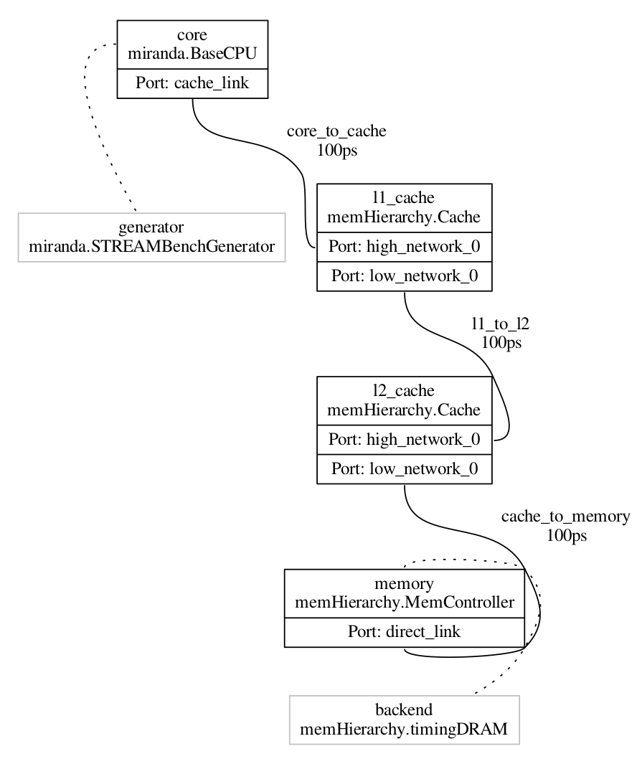
Viewing Configuration Graph
Let’s take a look at how SST views our system
Re-run demo_4 but add a command to dump the configuration graph
This gives you a GraphViz formatted file
You can install a JPEG previewer in VS Code to see the output.
Is this how you expected your system to look?
With this in mind, let’s add a second Miranda core…
$ sst --output-dot=graph_demo_4.dot –dot-verbosity=10 demo_4.py
$ dot –Tjpg graph_demo_4.dot –o graph_demo_4.jpg

Slide 80
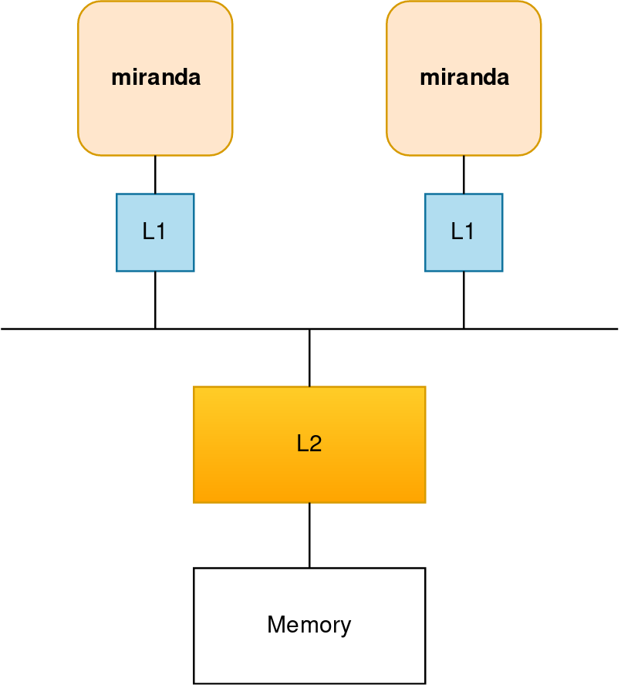
Running a Simulation – Add Components, Second Miranda
Copy configuration
Add an a second Miranda generator
What else might you need?
Dump the wiring diagram to verify the model
Launch simulation
$ cp demo_4.py demo_5.py
How about another L1 cache?
How are you going to wire everything together? How about a bus?
$ sst demo_5.py

Slide 81
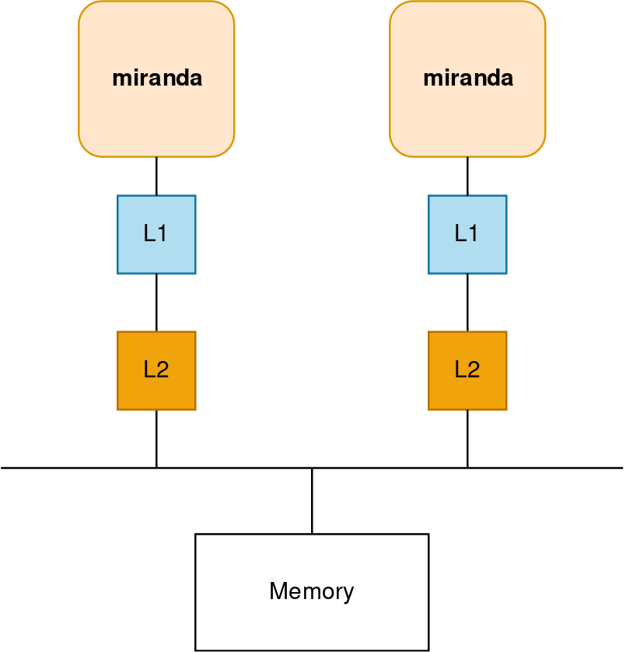
Running a Simulation – Add Components, Second L2
Copy configuration
Add L2 cache and move both above the bus
Launch simulation
$ cp demo_5.py demo_6.py
$ sst demo_6.py

Slide 82
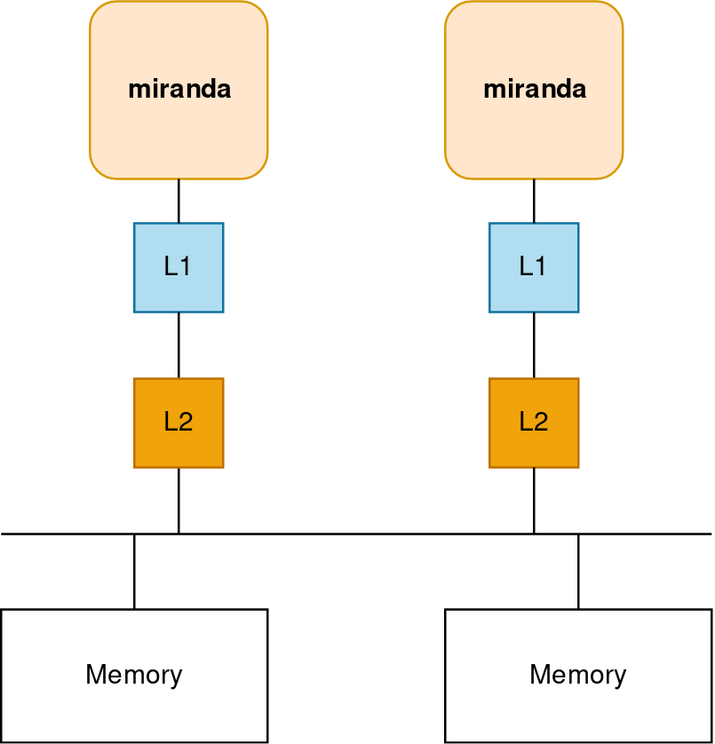
Running a Simulation – Add Components, Secondary Memory
Copy configuration
Add an a second L2 and memory controller
Think carefully about how addressing should will work…
Launch simulation
$ cp demo_6.py demo_7.py
Can you still use a bus?
Can the talk directly to the memory controller?
$ sst demo_7.py

Slide 83
Getting Help & Extending SST

Slide 84
Extending SST
SST was designed for extensibility
Components/subcomponents can be added without touching SST Elements
Example: write a new prefetcher and have memH caches use it → no changes to memHierarchy
SST-Core APIs are stable → one year deprecation period
Element APIs may be less so but generally try to keep them consistent
Many users start with SST Elements and then build their own customized libraries
Partially or completely replacing SST Element functionality
Many approaches to using SST
Core only: Write your own components from scratch
Start from existing Elements and replace components/subcomponents to meet your needs
Wrap existing simulators and insert as components or subcomponents

Slide 85
Extending SST: Resources
Example element library
Components demonstrating links, ports, clocks, event handling, etc.
sst-elements/src/sst/elements/simpleElementExample/
simpleSimulation
Simulates a car wash (a little more complex than example elements)
Example external element library
Demonstrates building and registering a new element library
https://github.com/sstsimulator/sst-external-element

Slide 86
Finally: Getting help
SST website contains lots of information (www.sst-simulator.org)
Downloading, installing, and running SST
Element libraries and external components
Guides for extending SST
Information on APIs
Information about current development efforts
Past tutorial slides and exercises
SST Github
Current development
Issues track user questions as well as development plans, bugs, etc.

Slide 87
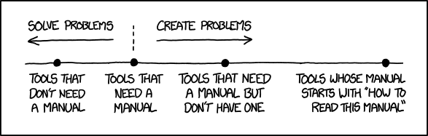
Part 1 wrap-up
SST is a parallel, flexible simulation framework
Can simulate many systems at many granularities
Capable of simulating modern architectures
Modular design for extensibility
Please keep us posted on your uses of SST as well as any capabilities you’ve added or would like to see added
The SST team wants to help you!
Documentation?
Examples?
Kittens?

Slide 88
Welcome!
Part 1: Introduction to SST
SST overview – Why, What, How
Basic simulation workflow
A Tour of SST Elements
Break 15:30 – 16:00
Part 2: Full System Modeling with SST
Networks Applications

Slide 89
Return at 16:00

Slide 90
Introduction Backup slides
Notes:
June 3: Morning: 10:00 to 10:30, Afternoon : 15:30 to 16:00
June 4: Morning: 10:00 to 1:30, Afternoon: 16:00 to 16:30 (however, this is because there’s a panel starting at 5).

Slide 91
SST uses Parallel Discrete Event Simulation (PDES)
DES breaks system behavior into individual events that update system state
Periodic (e.g., clock) or aperiodic (e.g., message)
Step 1 Treat simulation as a graph of components connected by links
Step 2 Exchange events and synchronize so that events never “arrive in the past” (Conservative PDES)
1
2
3
4
5
6
7
8
9
2
3
4
5
6
7
8
9
1
2
3
4
5
6
7
8
9

Slide 92
Merlin Models

Slide 93
Merlin: Network Simulator
Low-level, flexible networking components that can be used to simulate high-speed networks (machine level) or on-chip networks
Capabilities
High radix router model (hr_router)
Topologies – mesh, n-dim tori, fat-tree, dragonfly, hyperx
Many ways to drive a network
Simple traffic generation models
MemHierarchy
Lightweight network endpoint models (Ember)
Application skeletons (Mercury)
Or, make your own

Slide 94
Merlin High Level Overview
hr_router
hr_router
Topology
Topology
PC
PC
PC
PC
Xbar
Xbar
PC
PC
PC
PC
PC
PC
PC
PC
PC = PortControl
LC = LinkControl
LC
LC
LC
LC
End Point
End Point
End Point
End Point

Slide 95
General Parameters
General
link_bw – bandwidth of the network links (in B/s or b/s)
hr_router
xbar_bw – per port bandwidth into router crossbar (in B/s or b/s)
flit_size – size of a flit (in B or b)
input_latency – input latency of router (in s)
output_latency – output latency of router (in s)
xbar_arb – crossbar arbitration unit to be used
hr_router/LinkControl
input_buf_size – size of input buffer for router/NIC (in B or b)
output_buf_size – size of output buffer for router/NIC (in B or b)

Slide 96
LinkControl – Endpoint Facing
Inherits from SST::Interfaces::SimpleNetwork
bool send(SST::Interfaces::SimpleNetwork::Request* req, int vn);
bool spaceToSend(int vn, int flits);
SST::Interfaces::SimpleNetwork::Request* recv(int vn);
bool requestToReceive( int vn ) { return ! input_buf[vn].empty(); }
void sendUntimedData(SST::Interfaces::SimpleNetwork::Request* ev);
SST::Interfaces::SimpleNetwork::Request* recvUntimedData();
void setNotifyOnReceive(HandlerBase* functor) { receiveFunctor = functor; }
void setNotifyOnSend(HandlerBase* functor) { sendFunctor = functor; }
bool isNetworkInitialized() const { return network_initialized; }
nid_t getEndpointID() const { return id; }
const UnitAlgebra& getLinkBW() const { return link_bw; }

Slide 97
SimpleNetwork::Request
class Request : public SST::Core::Serialization::serializable {
public:
nid_t dest; /*!< Node ID of destination */
nid_t src; /*!< Node ID of source */
int vn; /*!< Virtual network of packet */
size_t size_in_bits; /*!< Size of packet in bits */
bool head; /*!< True if this is the head of a stream */
bool tail; /*!< True if this is the tail of a stream */
private:
Event* payload; /*!< Payload of the request */
public:
inline void givePayload(Event *event);
inline Event* takePayload();
inline Event* inspectPayload();
protected:
TraceType trace;
int traceID;

Slide 98
LinkControl-PortControl Interactions
LinkControl and PortControl share data and negotiate various parameters during the init() phase
Each LC/PC pair will negotiate link bandwidth. It is set to the minimum of the two set bandwidths
PortControl will notify the LinkControl of the network ID used to address it
PortControl will report FLIT size to the LinkControl
LinkControl notifies PortControl of the desired Virtual Networks to be used
This is a deprecated feature. Number of VNs is now set directly through the router
The LinkControl and PortControl objects manage send credits

Slide 99
PortControl/LinkControl Statistics
packet_latency (LC only)
For each packet, adds latency to statistics object (side effect is that it counts the number of packets received at an endpoint)
send_bit_count
For each packet, adds the size in bits to the statistics object (side effect is that it counts number of packets sent on a port)
output_port_stalls
For each interval where data is present, but can’t be sent due to lack of send credits, add the time stalled to statistics object
idle_time (PC only for now)
For each interval where no data is present to be sent, add total idle time to statistics object

Slide 100
ReorderLinkControl
Inherits from SST::Interfaces::SimpleNetwork
Contains a SimpleNetwork interface object to talk to the “physical” layer (this is typically just a LinkControl).
Puts a sequence number on each packet and reorders packets on the receive-side before giving them to endpoint
Allows endpoint models that can’t handle out of order receipt of packets to use network models that don’t guarantee ordering
Currently assumes “infinite” resources for buffer and reordering

Slide 101
Crossbar Arbitration
xbar_arb_rr
Round robin allocation – first across ports, then across virtual channels
xbar_arb_lru
Least recently used – across all port/VC pairs
xbar_arb_age
Oldest packets get higher priority
xbar_arb_rand
Random priority assigned to each port/VC pair each arbitration cycle

Slide 102
Topology Module
Router knows nothing about topology/routing without loading a topology module
Can use static and/or dynamic routing
Available topologies
SingleRouter
Mesh
Torus
Fattree
HyperX/Flattened Butterfly
Dragonfly
PolarFly/PolarStar

Slide 103
Topology Class – More on this later
virtual void route_packet(int port, int vc, internal_router_event* ev) = 0;
virtual internal_router_event* process_input(RtrEvent* ev) = 0;
virtual PortState getPortState(int port) const = 0;
bool isHostPort(int port) const;
virtual std::string getPortLogicalGroup(int port) const;
virtual void routeInitData(int port, internal_router_event* ev, std::vector<int> &outPorts) = 0;
virtual internal_router_event* process_InitData_input(RtrEvent* ev) = 0;
virtual int computeNumVCs(int vns);
virtual int getEndpointID(int port);
virtual void recvTopologyEvent(int port, TopologyEvent* ev);

Slide 104
Configuring a Merlin Simulation

Slide 105
Merlin/Ember Python Modules
Merlin and Ember provide built-in Python modules to make configuring simulations easier
Wires up the topology based on user supplied parameters
Allows simulated jobs (endpoint models) to be easily allocated to the network
The Python modules are built off of five primary base classes:
System – Overall system with functions to allocated jobs and build the simulation
Topology – Controls the network topology and parameters
RouterTemplate – Allows the ability to swap in different router models
In practice, there is only one current model: hr_router
Job – Jobs are mapped to the system using the job allocation functions and contains all the parameters for running the given job on the system
PlatformDefinition – allows you to capture all or part of the platform parameters and load them into a simulation instead of having to repeat this information in every input file

Slide 106
Ember – Lightweight Network Endpoint
Ember Motif
High Level Communication Pattern and Logic
Generates communication events
Ember Engine
User
Binary
Event to Message Call, Motif Management
Handles the tracking of the motif
Hermes API
Message Passing Semantics
Collectives, Matching, etc.
Firefly
Packetization and Byte Movement Engine
Generates packets and coordinates with network
Merlin Network
Flit Level Movement, Routing, Delivery
Moves flits across network, timing, etc.

Slide 107
Block Diagram of Python Network Configuration Classes
System
Topology
Allocation
Jobs
net_if
net_if
net_if
Router
Template

Slide 108
System
After configuring the System, the build() function is called to generate the configuration graph. Configuration options (some of these can be set in a PlatformDefinition file):
topology: set the topology to use. See next slide for available topologies
allocation_block_size: sets the number of contiguous endpoints that will be used for allocation. Only currently used when simulating multiNIC nodes
Allocate jobs to system: jobs are allocated using the allocateNodes() function. The following allocation algorithms can be used, and each job can use a different allocation using the remaining nodes in system:
Random – randomly allocate ranks to the available nodes
Linear – allocate nodes in order based on number used by topology
Random-linear – allocate linearly in a randomly selected subset of nodes
Interval – allocate N nodes every M endpoints (this is handy for reserving nodes for things like I/O nodes in the network)
Indexed – provide a list of ordered endpoints to allocate the job to (all endpoints in the list must still be unallocated in the system)

Slide 109
Topology
Controls the topology and all the high level network parameters (for example link bandwidth). The build function is called during the System.build() function
Can set the type of router to use by setting MyTopology.router, or can use the default (hr_router)
Supported topologies:
Dragonfly – uses 1D all-to-all groups
Hyperx - can be of any dimension, with any number of links per dimension
Fattree – built using individual routers (no support for consolidated routers)
Mesh/Torus – can be of any dimension, with any number of links per dimension
SingleRouter – just a single router (used mostly to mimic crossbars on chip)

Slide 110
Topology: Mesh/Torus
Implements an N-dimensional torus or mesh
shape
Gives the number of routers in each dimension
Examples: 16x16x16, 4x4x4x4x4
width
Gives number of links between routers in each dimension
Example: 1x1x1, 4x8x4, 3x3x3x3x3
local_ports
Gives number of hosts connected to each router
// Create a Torus topology
topology = topoTorus()
// Set shape to 3D torus with 16 routers per
// dimension
topology.shape = “16x16x16”
// 8 links between routers in each dimension
topology.width = “8x8x8”
// 16 endpoints per router
topology.local_ports = 16

Slide 111
Topology: HyperX/Flattened Butterfly
Implements and N-dimensional hyperX/flattened butterfly
shape
Gives the number of routers in each dimension
Examples: 16x16x16, 4x4x4x4x4
width
Gives number of links between routers in each dimension
Example: 1x1x1, 4x8x4, 3x3x3x3x3
local_ports
Gives number of hosts connected to each router
// Create a hyperX topology
topology = topoHyperX()
// Set shape to 3D torus with 16 routers per
// dimension
topology.shape = “16x8x16”
// Keep same bisection BW for each dimension
// by doubling links in small dimension
topology.width = “1x2x1”
// 16 endpoints per router
topology.local_ports = 16

Slide 112
Topology: Dragonfly
Implements a dragonfly topology with fully connected local group
hosts_per_router
Number of hosts connected to each router
routers_per_group
Number of routers per local group
intergroup_links
Number of links between each pair of groups
intragroup_links
Number of links between each router pair in a group
num_groups
Total number of groups in the topology
algorithm
Routing algorithm to use
minimal, min-a, valiant, ugal
Total number of hosts is:
hosts_per_router * routers_per_group * num_groups
// Create a dragonfly topology
topology = topoDragonFly()
// Set network parameters
topology.hosts_per_router = 16
topology.routers_per_group = 16
topology.intragroup_links = 2
topology.intergroup_links = 8
topology.num_groups = 32
// Set the routing algorithm
topology.algorithm = “ugal”
// Get the total number of nodes
num_nodes = topology.getNumNodes()

Slide 113
Topology: Fattree
Implements an N-level fattree
shape
Specifies the number of up and down ports at each level of the fattree. Equal up and down links indicates no bandwidth tapering, while unequal numbers indicated tapering. Highest level only specified down links:
Specified down,up:down,up:down,up:down
Total number of nodes is computed by multiplying all the ”downs” together
Examples:
18,18:18,18:36 (largest 3 level fattree using 36 port router with 11,664 hosts)
24,12:18,18:18 (3 level fattree with 50% bandwidth taper out of first level with 7,776 hosts)
These logically match typical fattrees, but are not necessarily physically the same (for example, does not consolidate routers at top level when not all ports are used in each router)

Slide 114
RouterTemplate
Controls which router model is used when the topology is built.
Router parameters are set on the RouterTemplate object. For hr_router, the main parameters are:
If using the default router, you can access the parameters of the RouterTemplate object as follows:
MySystem.topology.router.link_bw = “100 Gbps”
MySystem.topology.router.input_buf_size = “12 kiB”
link_bw
flit_Size
xbar_bw
num_vns
input_latency
output_latency
input_buf_size
output_buf_size

Slide 115
Job
The Ember Python module uses the Job abstraction to easily configure Ember jobs using the Merlin network models.
To configure a set of motifs using MPI, use EmberMPIJob
Constructor takes the following parameters:
job_id – unique ID to identify the job
num_nodes – number of network endpoints to use in the system
numCores – number of cores (MPPI ranks) per node to simulate
nicsPerNode – number of NICs to simulate per node
Each rank will get mapped to only one NIC, and numCores must divide evenly by nicsPerNode
The System allocation block size must be a multiple of the nicsPerNode
Must set the nic parameter to be the network interface corresponding to the router used in topology (for hr_router either LinkControl or ReorderLinkControl)
Add motifs to the job using the addMotif() function. Examples:
myJob.addMotif(“Halo3D26 pex=32 pey=32 pez=32 nx=20 ny=20 nz=20 iterations=1”)
myJob.addMotif(“Allreduce”)
There are a large number of other parameters which are best set in a PlatformDefinition file (see next slide)

Slide 116
PlatformDefinition
The various objects in the simulation will “subscribe” to a set of named parameters and class types that can be used to configure the simulation objects, which can set using the PlatformDefinition interface:
PlatformDefinition.loadPlatformFile(”firefly_platform")
Loads a python file that contains platform definitions
Platform files can contain more than on platform definition
Multiple platform files can be loaded
PlatformDefinition.setCurrentPlatform(”firefly-platform-base")
Set the specified definition as the current platform (can only load one platform at a time)
PlatformDefinition.compose(platformName, …)
Allows you to compose multiple PlatformDefinitions into a new PlatformDefinition
For example, ember parameters and network definition can come from different platform files and be composed together since you can only have one active platform
Platform files can be provided by Sandia, vendors, etc.

Slide 117
Example Configuration using Ember

Slide 118
Example Configuration: merlin-ember-example.py
# Import base sst module
import sst
# Import necessary merlin modules
from sst.merlin.base import *
from sst.merlin.endpoint import *
from sst.merlin.interface import *
from sst.merlin.topology import *
from sst.ember import *
# Include the firefly defaults to get default
# parameters for NIC and network stack
PlatformDefinition.setCurrentPlatform(
"firefly-defaults")
# Setup the topology
topo = topoDragonFly()
topo.hosts_per_router = 2
topo.routers_per_group = 4
topo.intergroup_links = 2
topo.num_groups = 4
topo.algorithm = ”ugal"]
topo.link_latency = "20ns"
# Set up the routers
router = hr_router()
router.link_bw = "4GB/s"
router.flit_size = "8B"
router.xbar_bw = "6GB/s"
router.input_latency = "20ns"
router.output_latency = "20ns"
router.input_buf_size = "4kB"
router.output_buf_size = "4kB"
router.num_vns = 1
router.xbar_arb = "merlin.xbar_arb_lru"
# Add router template to topology
topo.router = router

Slide 119
Example Configuration: merlin-ember-example.py
# Set up the network interface
networkif = ReorderLinkControl()
networkif.link_bw = "4GB/s"
networkif.input_buf_size = "4kB"
networkif.output_buf_size = "4kB"
# Create the ember job
ep = EmberMPIJob(0,topo.getNumNodes())
ep.network_interface = networkif
ep.addMotif("Init") # required first motif
ep.addMotif("Allreduce")
ep.addMotif("Fini") # required last motif
ep.nic.nic2host_lat= "100ns"
# Create the system object
system = System()
system.setTopology(topo)
# Allocate the job using linear placement
system.allocateNodes(ep,"linear")
# Build the system
system.build()
% sst merlin-ember-example.py
Allreduce: ranks 32, loop 1, 1 double(s), latency 5.192 us
Simulation is complete, simulated time: 18.7055 us

Slide 120
Hands On with Merlin and Ember
Things to try:
Change the ember motif being run; possible other motifs to run:
Halo3d26
sweep3D
Change some of the network parameters
link_bw, input/output latencies, etc
Use a different routing algorithm
minimal, min-a, or valiant
Try random allocation of the job
Double the size of the network and add a second job
Try different allocations (linear, random, random-linear)

Slide 121
System-Scale Simulation using Ember, Mercury and Merlin
SST Tutorial – IPDPS 2025
Joseph Kenny, Sandia National Laboratories
SST Development Team, Sandia National Laboratories

Slide 122
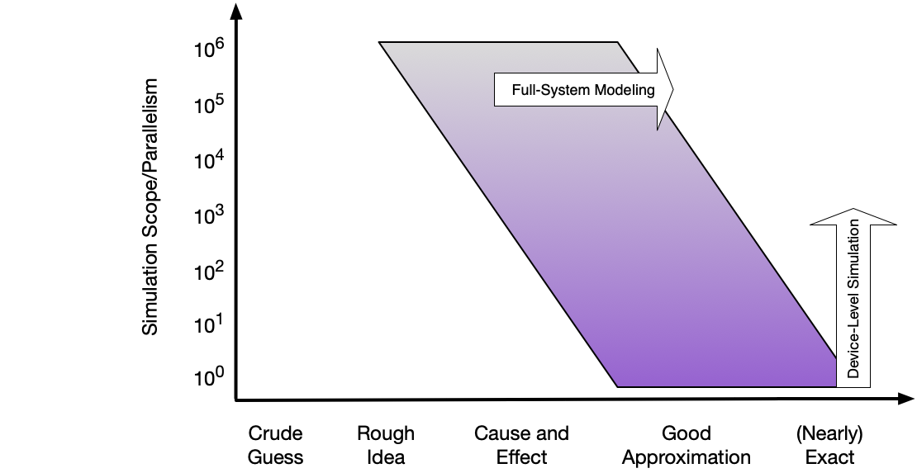
System Scale Modeling
Context for Ember/Mercury discussion
Notes:
June 3: Morning: 10:00 to 10:30, Afternoon : 15:30 to 16:00
June 4: Morning: 10:00 to 1:30, Afternoon: 16:00 to 16:30 (however, this is because there’s a panel starting at 5).

Slide 123
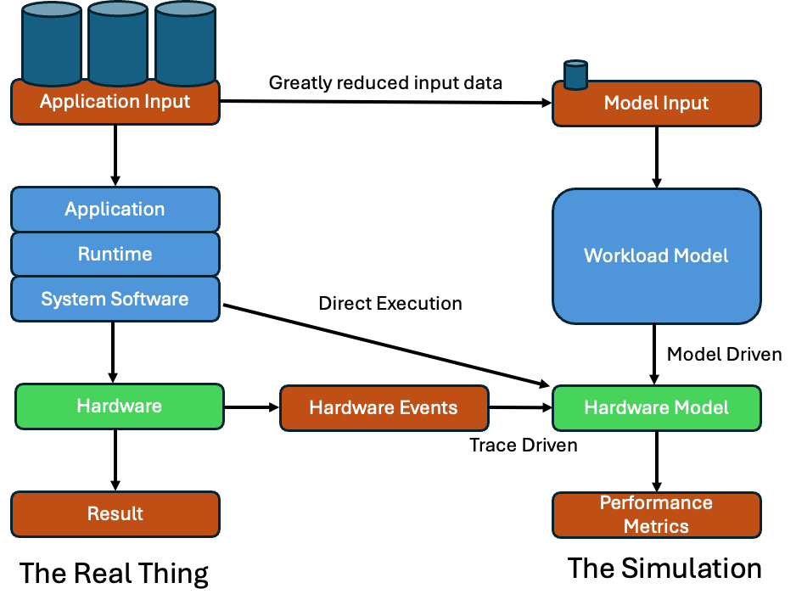
Simulation Approaches
Direct execution is unachievable for full system scale
Traces require full execution at target scale or some way to scale up traces accurately (difficult)
Ideal workload models use parameterized representation to reproduce data movement and computation – full results not computed
Notes:
June 3: Morning: 10:00 to 10:30, Afternoon : 15:30 to 16:00
June 4: Morning: 10:00 to 1:30, Afternoon: 16:00 to 16:30 (however, this is because there’s a panel starting at 5).

Slide 124
Workload Modeling at Scale
Ember/Mercury/Merlin allow accurate modeling of workload data movement
There is no prescribed method to account for computation
Any computation in the model itself is performed on the host CPU
Simulation time does not advance due to host computation – explicit addition of computation modeling is required
Full array of models available to simulation designer
Fixed timing estimates from small scale traces or simulations
Simple models (e.g. roofline)
Full device level simulation at small scale
Multifidelity: abstract model parameterized with results from direct execution (very active research area)
Notes:
June 3: Morning: 10:00 to 10:30, Afternoon : 15:30 to 16:00
June 4: Morning: 10:00 to 1:30, Afternoon: 16:00 to 16:30 (however, this is because there’s a panel starting at 5).

Slide 125
System-Scale Simulation: Ember
SST Tutorial – IPDPS 2025
Joseph Kenny, Sandia National Laboratories
SST Development Team, Sandia National Laboratories

Slide 126
Ember: Network Traffic Generator
$ sst-info ember
Light-weight endpoint for modeling network traffic
Enables large-scale simulation of networks where detailed modeling of endpoints would be expensive
Packages patterns as motifs
Can encode a high level of complexity in the patterns
Generic method for users to extend SST with additional communication patterns
Intended to be a driver for the Hermes, Firefly, and Merlin communication modeling stack
Uses Hermes message API to create communications
Abstracted from low-level, allowing modular reuse of additional hardware models
Network driver
Processor
Memory
Network/NoC
Other

Slide 127
Ember: Motifs
$ sst-info ember | grep Motif
Motifs are lightweight patterns of communication
Tend to have very small state
Extracted from parent applications
Models as an MPI program (serial flow of control)
Many motifs acting in the simulation create the parallel behavior
Example motifs
Halo exchanges (1, 2, and 3D)
MPI collections – reductions, all-reduce, gather, barrier
Communication sweeping (Sweep3D, LU, etc.)
Network driver
Processor
Memory
Network/NoC
Other

Slide 128
Ember: Motifs (continued)
$ sst-info ember.EmberEngine
The EmberEngine creates and manages the motif
Creates an event queue which the motif adds events to when probed
The Engine executes the queued events in order, converting them to message semantic calls as needed
When the queue is empty, the motif is probed again for events
Events correspond to a specific action
E.g., send, recv, allreduce, compute-for-a-period, wait, etc.
Network driver
Processor
Memory
Network/NoC
Other

Slide 129
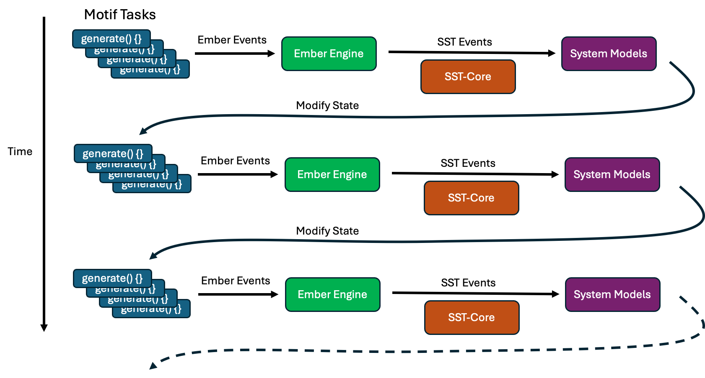
Ember Execution Loop

Slide 130
System-Scale Simulation: Mercury
SST Tutorial – IPDPS 2025
Joseph Kenny, Sandia National Laboratories
SST Development Team, Sandia National Laboratories

Slide 131
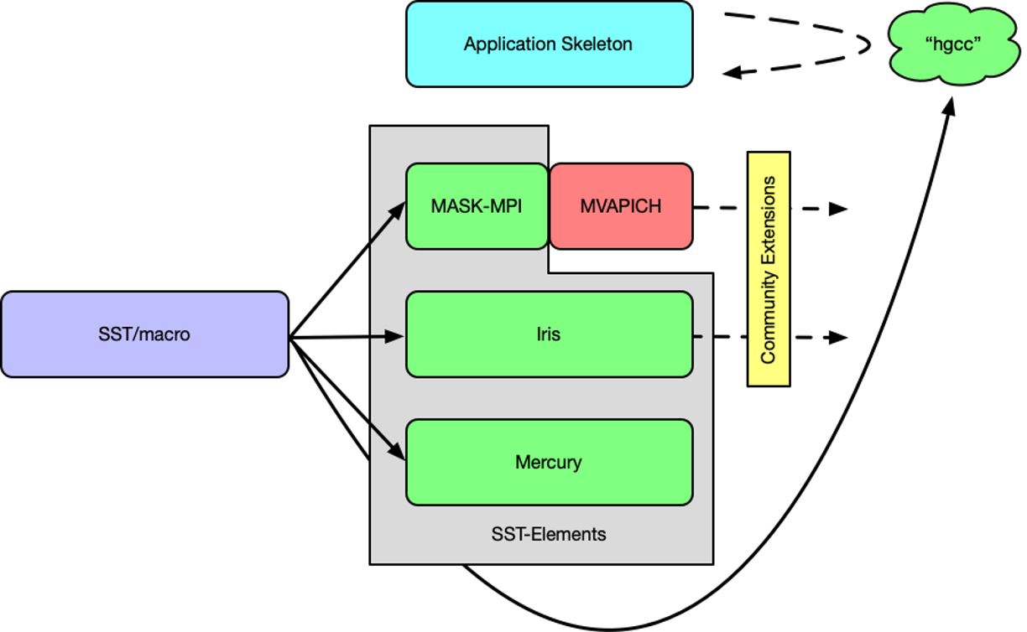
Introducing the Mercury Environment
Mercury is a recent effort to bring workload modeling technology developed by the SST/macro project into a fully integrated environment within SST-Elements
Mercury provides foundational components for efficiently building flexible workload simulations
Notes:
June 3: Morning: 10:00 to 10:30, Afternoon : 15:30 to 16:00
June 4: Morning: 10:00 to 1:30, Afternoon: 16:00 to 16:30 (however, this is because there’s a panel starting at 5).

Slide 132
Automation tick-tock (philosophical digression)
Oversimplified but instructive way to differentiate SST-Elements and SST/macro:
SST/macro is a simulator (drink the Kool-Aid) -- often more end-user friendly, not as easy to mix-and-match/extend.
SST-Elements is a toolkit, aimed at simulation developers, that assists building simulators – more challenging to configure but functionality is well-encapsulated by design.
SST/macro strove towards automation and hiding complexity – great when it worked, hard to understand and work around with it didn't work; it is also fragile and challenging to maintain.
The design philosophy for Mercury is to support and encourage straightforward solutions to workload modeling challenges. Some automation from SST/macro (e.g. source-to-source compiler) is being pulled over, but reducing complexity is a high-level goal.
Notes:
June 3: Morning: 10:00 to 10:30, Afternoon : 15:30 to 16:00
June 4: Morning: 10:00 to 1:30, Afternoon: 16:00 to 16:30 (however, this is because there’s a panel starting at 5).

Slide 133
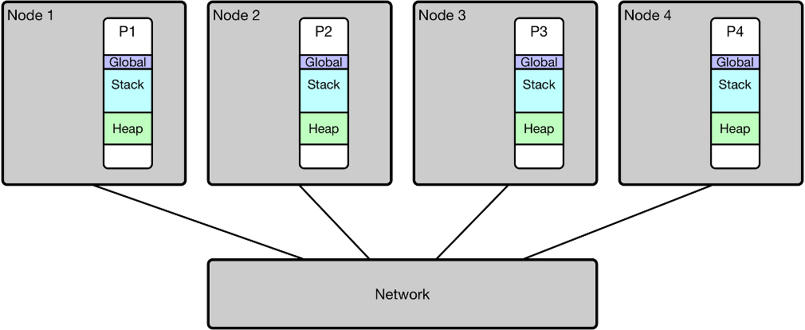
Mercury Concepts: Pedagogical Target System
A simplified "supercomputer"
Notes:
June 3: Morning: 10:00 to 10:30, Afternoon : 15:30 to 16:00
June 4: Morning: 10:00 to 1:30, Afternoon: 16:00 to 16:30 (however, this is because there’s a panel starting at 5).

Slide 134
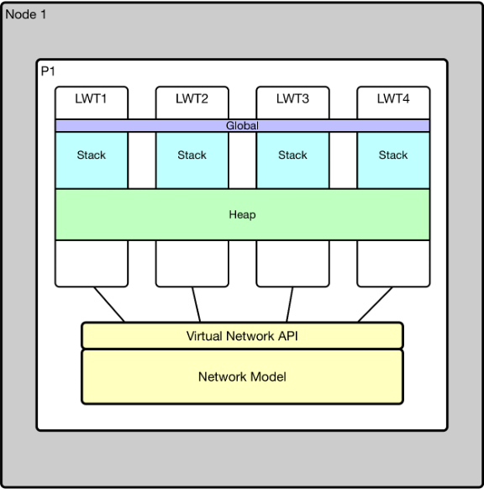
Mercury Concepts: Lightweight Threads
Simulation: run virtual processes/tasks as lightweight (user space) threads to manage overhead
Executes relatively unmodified application code, but on host system not simulated devices
Challenges
Single address space means global data is now shared between virtual processes (shared heap is ok)
Compute/memory blow up if you try to emulate large system
Some host features need to be replaced with implementations appropriate for simulation environment (e.g. threading)
Compilers can help with some of these problems
This is the fundamental capability that Mercury provides
Notes:
June 3: Morning: 10:00 to 10:30, Afternoon : 15:30 to 16:00
June 4: Morning: 10:00 to 1:30, Afternoon: 16:00 to 16:30 (however, this is because there’s a panel starting at 5).

Slide 135
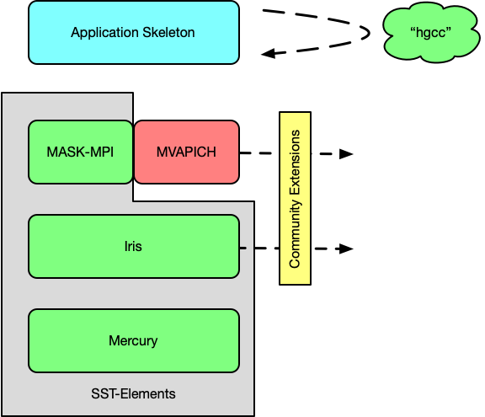
Mercury Environment: Modular Building Blocks for Workload Models
Breaks monolithic nature of SST/macro
Iris: communication middleware
SUMI – low-level messaging interface
Libfabric provider targeting SUMI
MASK-MPI: port of SST/macro simulator-specific MPI implementation (targets SUMI)
Lightweight
Broad suppport of MPI features
sst-hgcc: compiler support
Privatize shared variables
Semi-automated skeletonization
Capability Demonstration – run full MVAPICH implementation over SUMI using hgcc skeletonization
Notes:
June 3: Morning: 10:00 to 10:30, Afternoon : 15:30 to 16:00
June 4: Morning: 10:00 to 1:30, Afternoon: 16:00 to 16:30 (however, this is because there’s a panel starting at 5).

Slide 136
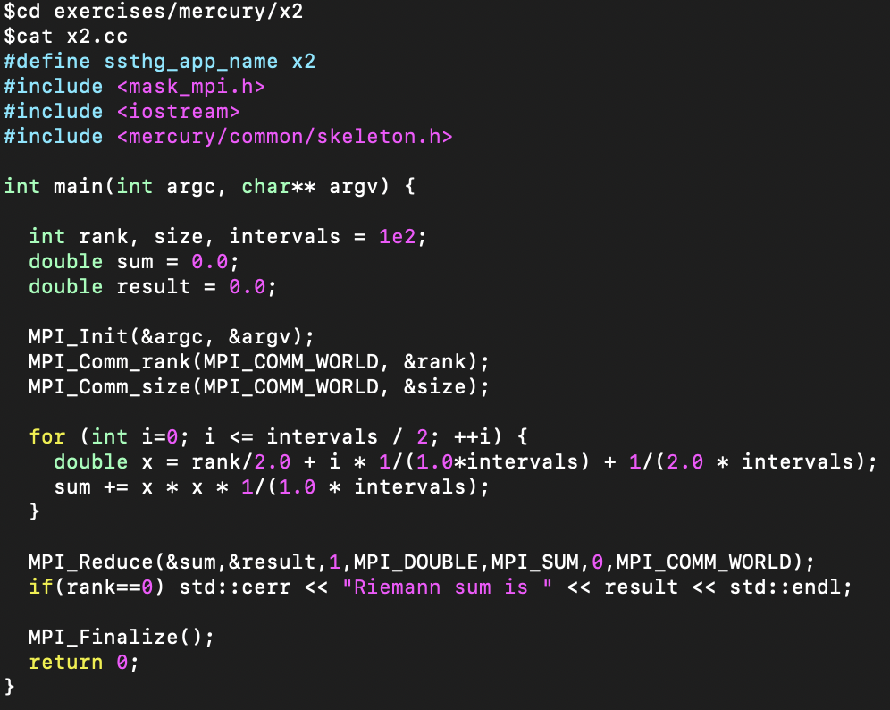
Mercury Example – Basic Skeletonization
Example – compute the Riemann sum for X*X over [0,1]
Straight MPI code aside from header modifications
How do we configure a simulation?...
Notes:
June 3: Morning: 10:00 to 10:30, Afternoon : 15:30 to 16:00
June 4: Morning: 10:00 to 1:30, Afternoon: 16:00 to 16:30 (however, this is because there’s a panel starting at 5).

Slide 137
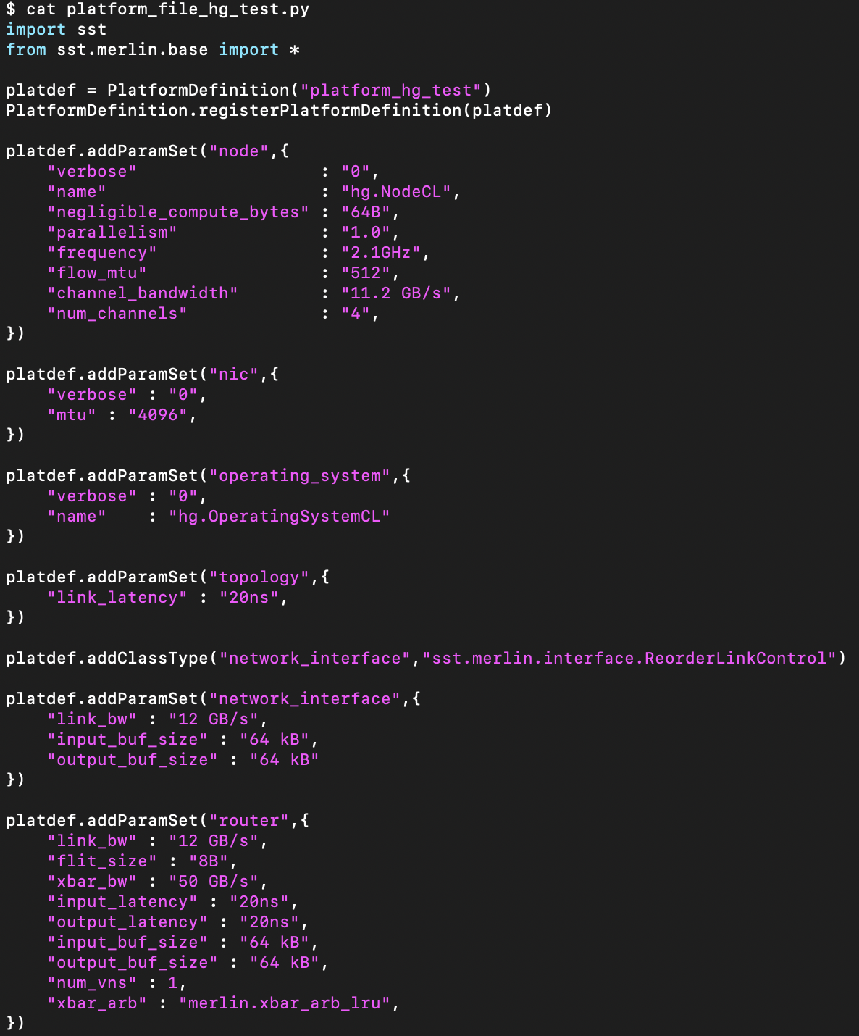
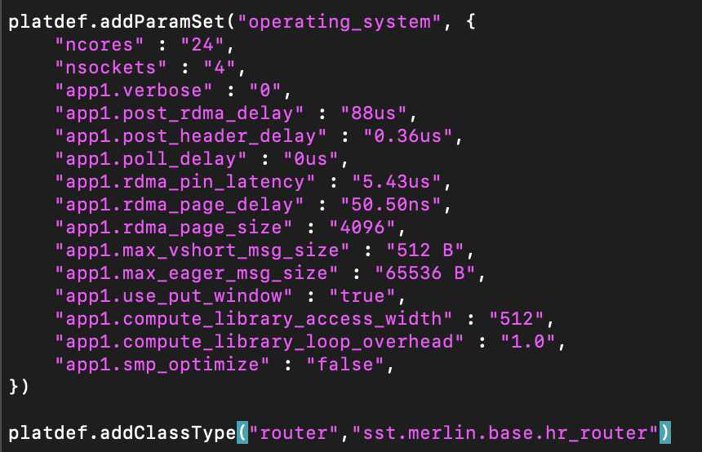
Mercury Example – Basic Skeletonization
Hg::OperatingSystem does the heavy lifting, loads/runs software stacks
Typical parameters for Merlin simulation
"CL" versions of Mercury components support simple ComputeLibrary delay modeling
Notes:
June 3: Morning: 10:00 to 10:30, Afternoon : 15:30 to 16:00
June 4: Morning: 10:00 to 1:30, Afternoon: 16:00 to 16:30 (however, this is because there’s a panel starting at 5).

Slide 138
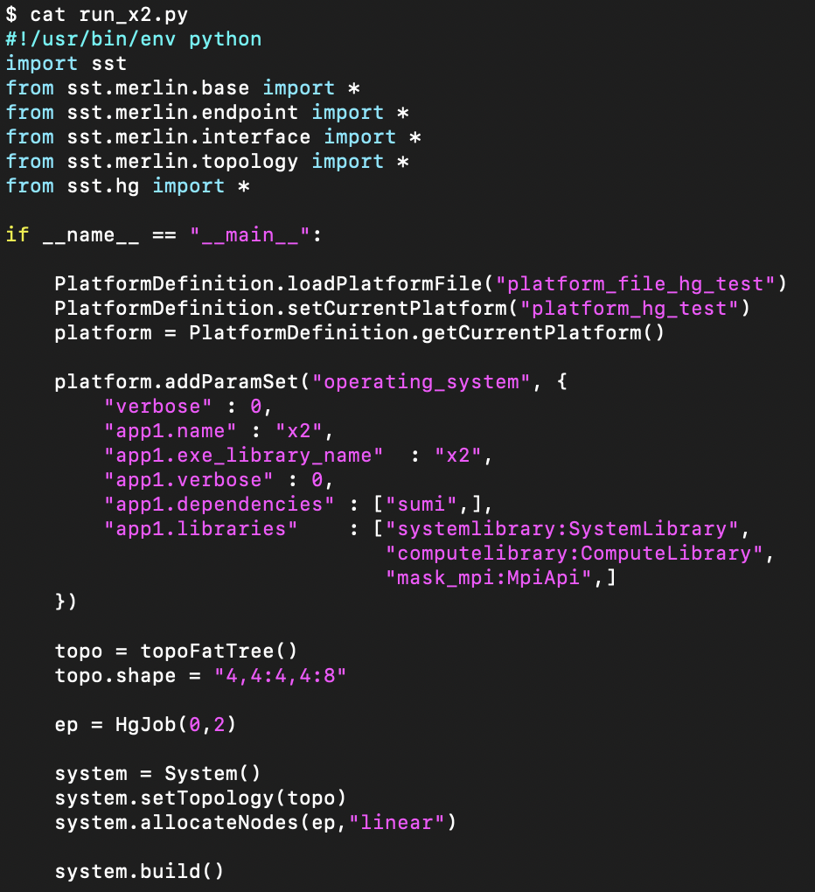
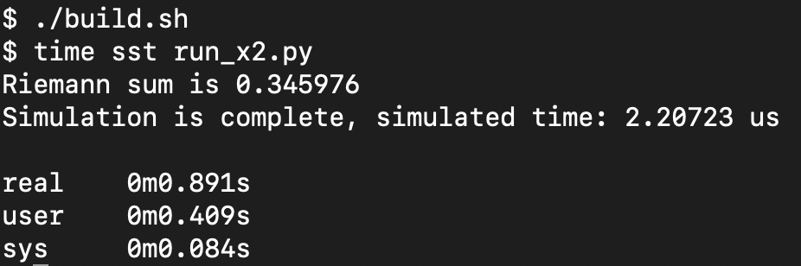
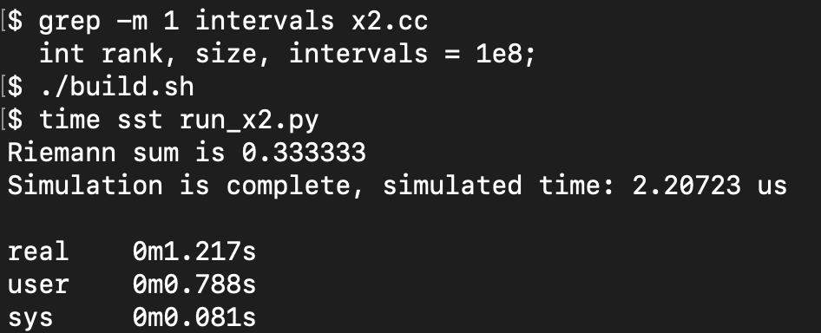
Mercury Example – Basic Skeletonization
What's different from an Ember input?
How to find application code
Libraries that aren't directly called by app
Libraries that are directly called by app
Libraries that are directly called by app
HgJob instead of EmberJob
Notes:
June 3: Morning: 10:00 to 10:30, Afternoon : 15:30 to 16:00
June 4: Morning: 10:00 to 1:30, Afternoon: 16:00 to 16:30 (however, this is because there’s a panel starting at 5).

Slide 139
Mercury Example – Basic Skeletonization
Not such an impressive result for 100 intervals
More intervals yields better result
Wall clock increase ~50%
Simulated time is unaffected
Notes:
June 3: Morning: 10:00 to 10:30, Afternoon : 15:30 to 16:00
June 4: Morning: 10:00 to 1:30, Afternoon: 16:00 to 16:30 (however, this is because there’s a panel starting at 5).

Slide 140
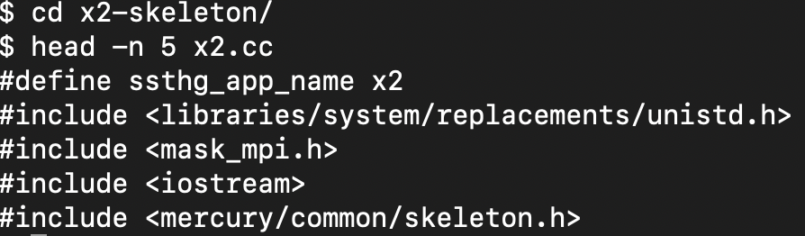
Exercise: Skeletonize x2.cc
Skeletonize – reduce computation and memory footprint while maintaining control flow and parameters for network operations
Important to know:
MPI send/recv buffers should be set to ssthg_nullptr;
The following header will allow you to call Mercury's sleep(int);
Notes:
June 3: Morning: 10:00 to 10:30, Afternoon : 15:30 to 16:00
June 4: Morning: 10:00 to 1:30, Afternoon: 16:00 to 16:30 (however, this is because there’s a panel starting at 5).

Slide 141
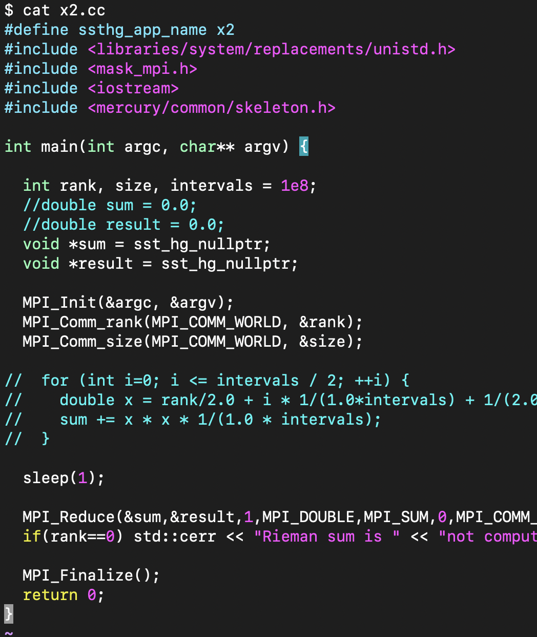
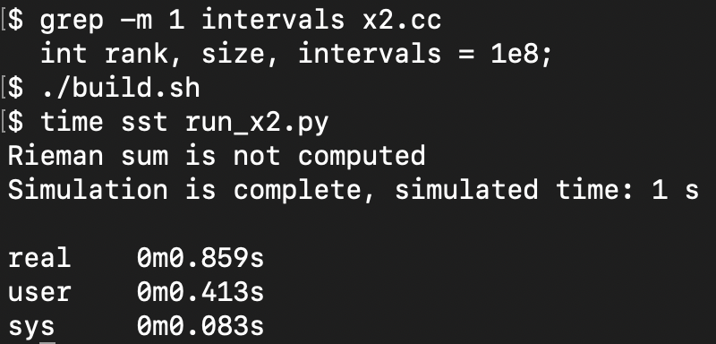
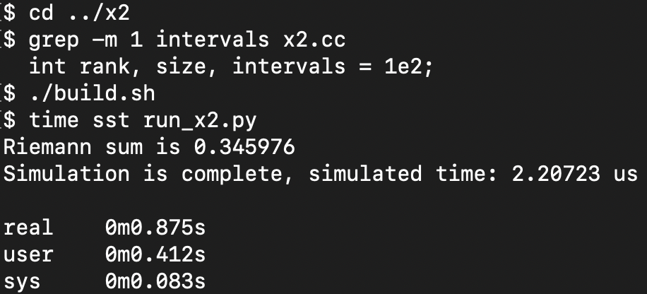
Mercury Example – Skeletonized x2.cc
Now simulated time has changed (we've replaced sleep() with a version that can advance simulation time).
Note, however that wall clock time is comparable to the version with minimal computation.
Notes:
June 3: Morning: 10:00 to 10:30, Afternoon : 15:30 to 16:00
June 4: Morning: 10:00 to 1:30, Afternoon: 16:00 to 16:30 (however, this is because there’s a panel starting at 5).

Slide 142
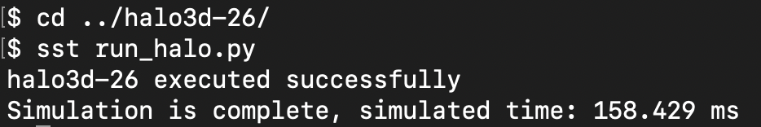
A More Complex Skeleton – halo3d-26
A slightly modified (fixed input parameters) halo3d-26 proxy application is included and compiled in mask-mpi (mask-mpi/skeletons).
Halo3d is a good entry point to explore more complicated skeleton applications -- try to run it via the provided input deck.
Notes:
June 3: Morning: 10:00 to 10:30, Afternoon : 15:30 to 16:00
June 4: Morning: 10:00 to 1:30, Afternoon: 16:00 to 16:30 (however, this is because there’s a panel starting at 5).

Slide 143
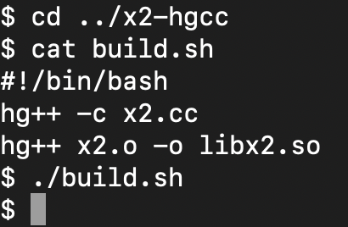
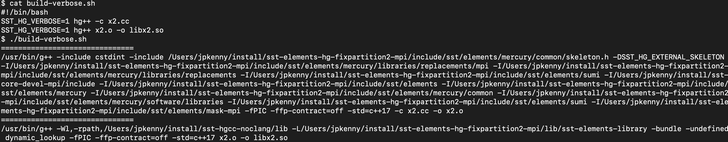
Advanced Topic – Compiling with sst-hgcc
sst-hgcc is a separate repo that provides experimental compiler support for building Mercury-compatible skeletons
Two modes:
Wrapper mode: alleviates tedious and error prone determination of compiler options (functional prototype)
LLVM-based source-to-source for shared variable privatization (functional prototype) and pragma based skeletonization assistance (upcoming)
Current implementation is fragile and difficult to maintain and build
Pro tip: user SST_HG_VERBOSE with hg++ to get suggested compiler options
Notes:
June 3: Morning: 10:00 to 10:30, Afternoon : 15:30 to 16:00
June 4: Morning: 10:00 to 1:30, Afternoon: 16:00 to 16:30 (however, this is because there’s a panel starting at 5).

Slide 144
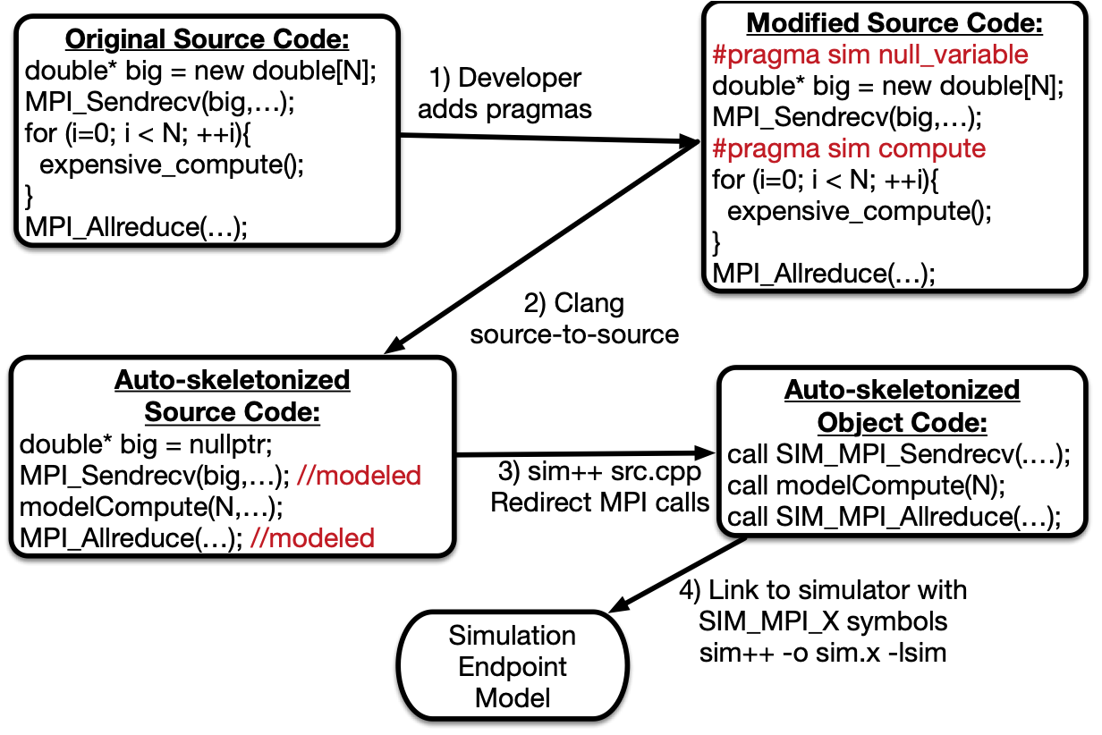
Advanced Topic – Source-to-source Compiler
See: Wilke, Jeremiah J., et al. "Compiler-assisted source-to-source skeletonization of application models for system simulation." High Performance Computing: 33rd International Conference, ISC High Performance 2018, Frankfurt, Germany, June 24-28, 2018, Proceedings 33. Springer International Publishing, 2018.
Notes:
June 3: Morning: 10:00 to 10:30, Afternoon : 15:30 to 16:00
June 4: Morning: 10:00 to 1:30, Afternoon: 16:00 to 16:30 (however, this is because there’s a panel starting at 5).

Slide 145
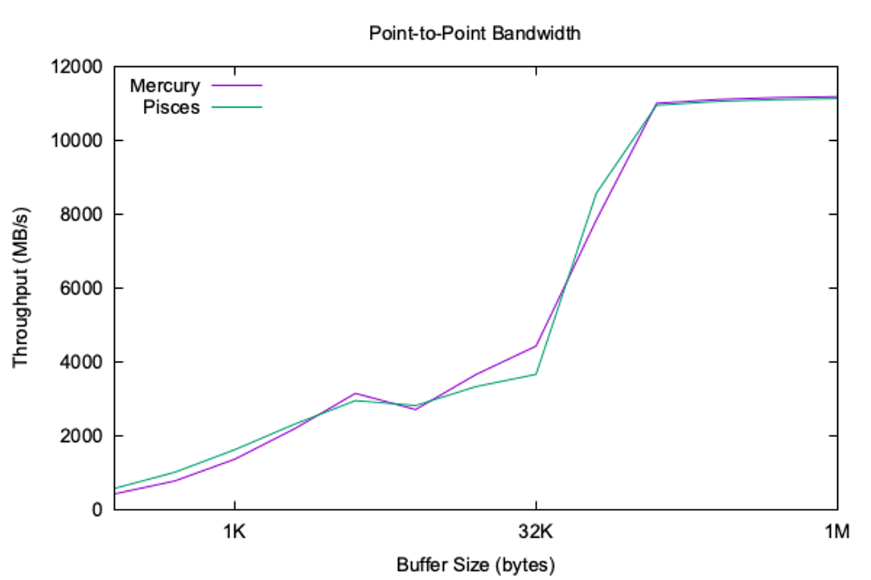
Mercury Results – Early Comparison of SST/macro and Mercury/Merlin
Pisces is the highest fidelity SST/macro network model
Very good agreement between completely independent network models
Notes:
June 3: Morning: 10:00 to 10:30, Afternoon : 15:30 to 16:00
June 4: Morning: 10:00 to 1:30, Afternoon: 16:00 to 16:30 (however, this is because there’s a panel starting at 5).

Slide 146
Introduction to the vanadis and balar Components
SST Tutorial – IPDPS 2025
Clay Hughes, Sandia National Laboratories
SST Development Team, Sandia National Laboratories
Architecture Accelerator Lab, Purdue University

Slide 147
Welcome!
Part 1: Introdcution to SST 2:00 – 2:15
Part 2: Introduction to vanadis 2:15 - 2:45
Part 3: Introduction to balar 2:45 – 3:15
Part 3: Introduction to rev 3:15 - 4:00
Break / Finish 4:00 - 4:30
Notes:
June 3: Morning: 10:00 to 10:30, Afternoon : 15:30 to 16:00
June 4: Morning: 10:00 to 1:30, Afternoon: 16:00 to 16:30 (however, this is because there’s a panel starting at 5).

Slide 148
Introduction to vanadis

Slide 149
Processor Models and SST
Ariel – PIN instruction trap and forward for memory requests
Utilize full range of X86-64 instructions (including complex vectorization)
Easy to use with binaries from the host, including large/complex binaries, dynamically linked
Forwards requests to the memory subsystem and maintains back-pressure in load/store queues to preserve approximate timing
Juno – simple in-order instruction using a (very) small but extensible ISA
Proof of concept for external processor components
Very fast to execute, but custom/simple ISA is assembly-based and cannot be used with high-level language/compiler
Miranda – state machine based core model for memory subsystem
Allows complex memory patters to be analyzed with very lightweight core models
Spike – external RISC-V model developed by Tactical Computing
GEM5 – previously integrated; not tested and does not support SST parallelization

Slide 150
Requirements for a Flexible Core Model
Want a processor core component that can utilize full range of SST capabilities
Ability to parallelize simulation of designs which may have multi/many-core processors with >1,000 cores and any hardware threads (using SST’s MPI and thread based PDES engine)
Ability to run for long simulation periods (billions of instructions)
Works natively with SST memory subsystem and accelerator models
Including time/periodic and event based output of statistics
Produces native SST statistics for feedback modeling (e.g. energy, DVFS, resilience etc)
Ability to extend/replace ISA using SST modules/sub-components
Not strong requirements but research interest in:
RISC-like core pipelines (use for modeling full server-class cores through to small accelerator like processors)
RISC-V and Arm ISA support
Possibility to replace sections of the processor model using SST sub-components to make models more extensible
Custom instructions and functional units

Slide 151
vanadis Pipeline Model
Initial research concept for a ISA-agnostic RISC pipeline model for SST
Provides operating system emulation mode (does not need to boot a kernel etc.)
Decoders are full SST sub-components so can be extended and swapped out
On a per-hardware thread or per-core basis
Does not require ISA to be compiled in (user can provide these later using sub-components)
Pipeline is out-of-order and parameterized to permit hardware exploration
Execute-at-execute pipeline model
Pipeline instructions are generic and agnostic to the specific ISA being used (so easy to add ISAs and use existing instructions that are regularly tested)
Functional units are fully extensible/swappable and individually parameterizable
Ability to add (custom) instructions into the pipeline and out-of-order engines comply with providing register dependencies and correct retirement

Slide 152
Example Configurations
Flexibility and parameterization of vanadis allows it to be used in many different design scenarios
Integration with SST allows significant degree of flexibility
Potential for different cores to have different ISAs (e.g. PIM use case
Mix-core Node
Accelerated Node
PIM Node

Slide 153
Single Core Example
Required elements
Vanadis
memHierarchy
Merlin
Example located in:
../vanadis/tests/basic_vanadis.py
Test harness can instantiate multiple CPUs but this example assumes a single CPU

Slide 154
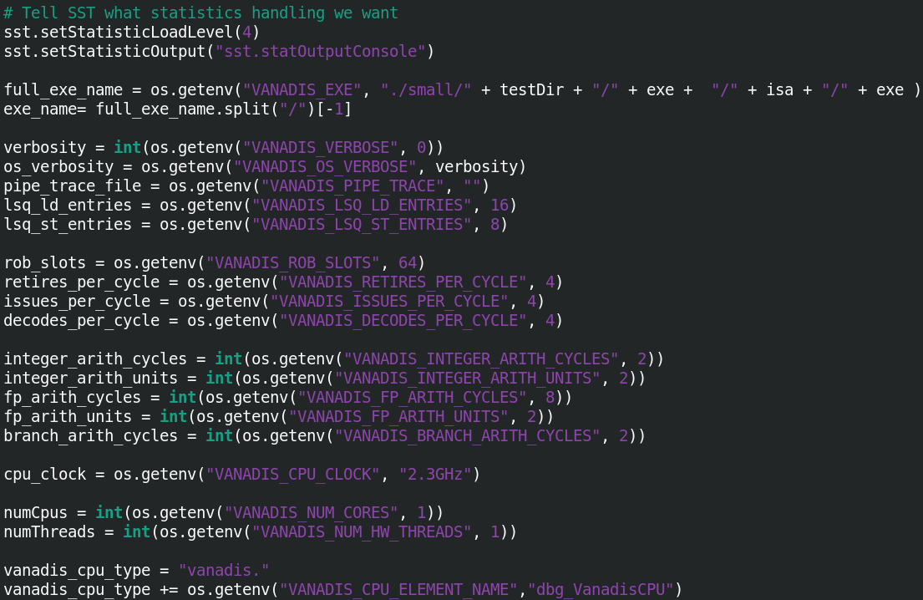
Global/System Parameters

Slide 155
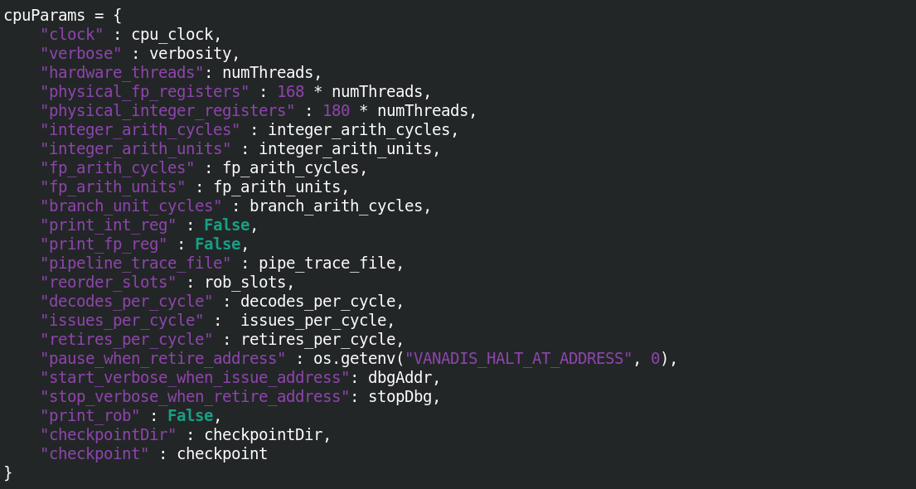
Core Parameters

Slide 156
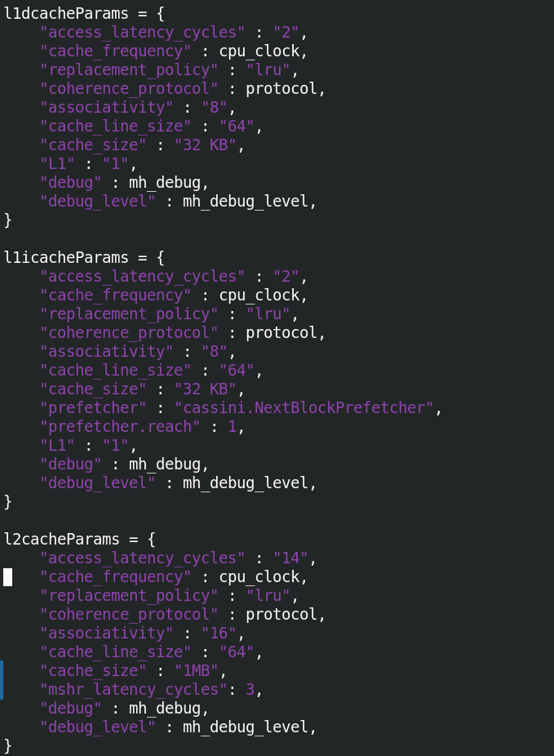
Cache Parameters

Slide 157
Example – basic_vanadis.py

Slide 158
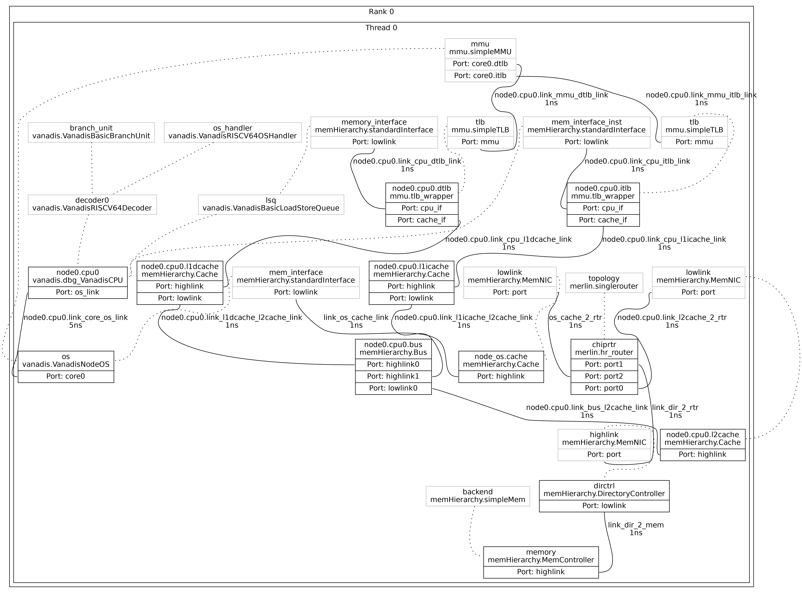
SST Configuration Graph – 1R1T
sst --output-dot=<> --dot-verbosity=10

Slide 159
SST Configuration Graph – 1R2T
sst --output-dot=<> --dot-verbosity=10

Slide 160
Accelerators and RoCC
Enable support for tightly-coupled accelerators
Leverages the Rocket Custom Coproeccoer (RoCC) interface
Takes advantage of the custom instruction encoding space within the RISC-V ISA while standardizing the control signals used by the accelerator
Enables early-stage software development targeting the accelerator
An essential capability since software support is often a major blocker in the deployment of systems with custom accelerators
Currently being tested with integration of analog Matrix Vector Multiplication (MVM) components (golem)
Modified LLVM compiler, initial software stack and application development has begun
https://github.com/sstsimulator/sst-elements/tree/master/src/sst/elements/golem

Slide 161
Introduction to balar

Slide 162

SST GPGPU Modeling Capability
Long history of GPGPU simulators, mostly from academia
GPGPUSim [Bakhoda, 2009]
Gem5+GPU [Power, 2014]
MacSim/Ocelot [Hyesoon, 2012], [Kerr, 2009]
Multi2Sim v5.0 [Gong, 2017]
NVArchSim
After a literature review and calls with the developers of GPGPUSim and Multi2Sim, the SST team chose GPGPUSim as the integration target
More amendable to SST integration
Software designed around well-defined objects
More tractable for SST workflows
Notes:
GPGPUSim
Modular design
Library is incomplete, authors only implemented what was required for their benchmarks
Instruction trace derived from PTX, SASS, and ELF (cuobjdump of binary)
Gem5+GPU
Ruby is used to model functional and timing simulations for memory accesses
The gem5 port interface is used to map Cuda cores in gem5 to gpgpu-sim
Supports a shared virtual address space between the CPU and GPU
MacSim is similar to GPGPU-Sim – host and device are split into separate streams
Ocelot generated device trace; Pin generates host trace
I could not get Ocelot to build correctly so I was unable to dig into how it works
Custom libraries are used to replace calls to device code and point them to the simulation environment
I could not get MacSim to link and actually run with SST
Multi2Sim (David Kaeli @ Northeastern)
Only supports 32b
Does support SASS; Global Addr. Space
NVArchSim
Discussed in FF2 (internal to Nvidia)

Slide 163
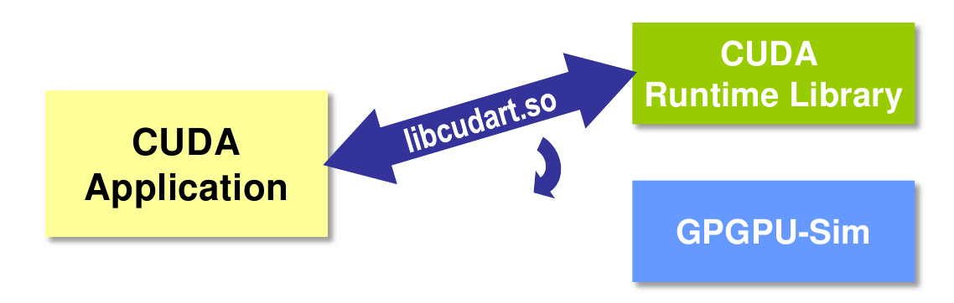
GPGPUSim Integration
GPGPUSim
Runs host code directly
Runs device code on a functional simulator
Interfaces with programs through a custom library, replacing native CUDA calls
Simulation split into functional and timing
Functional
CTA
Pool of threads with access to shared memory
Thread
PC + registers + allocated memory
Instruction
1:1 mapping with opcode and implementation function; simulated at issue
Timing
SIMT Core
Roughly equivalent to Fermi’s SM
Cache
L1 → Per-core, write-through/no-allocate
L2 → Device, write-back/no-allocate
Interconnect
Intersim (Booksim)
Backing store
GDDR3/GDDR5
Notes:
One of the drawbacks of just using GPGPUSim is that it has no processor model; it runs host code directly on the system. While this makes simulation time fast, it only allows for studies on GPU performance.
The primary reason that GPGPUSim was chosen as the integration target was because it had well-defined functional and timing models, which would allow us to easily replace the timing portion with SST components while keeping the functional model (mostly) intact.

Slide 164
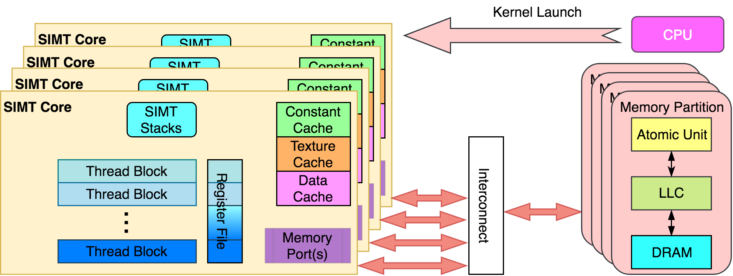
GPGPUSim Integration
Functional
SIMT units track default functional model from GPGPUSim
Timing
SIMT units maintain execution timing; Booksim is used for the interconnect; and simple timing models are used for the memory partition
Notes:
Functional model for PTX/SASS
PTX = Parallel Thread eXecution: A scalar low-level, data-parallel virtual ISA defined by Nvidia
SASS = Native ISA for Nvidia GPUs
Not DirectX, Not shader model N, Not AMD’s ISA, Not x86, Only PTX or SASS.
Timing model for the compute part of a GPU
Not for CPU or PCIe
Only models microarchitecture timing relevant to GPU compute

Slide 165
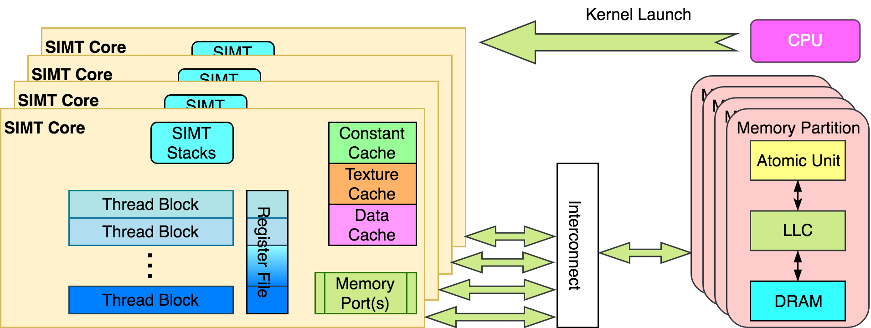
GPGPUSim Integration
SST
SST
SST
SST
Plan to keep the SIMT units and replace everything else
CPU → SST execution component (Vanadis, Ariel, etc.)
Interconnect → SST networking component (Shogun, Merlin, Kingsley, etc.)
Memory Partition & Caches→ SST memHierarchy component for caches and various other backends for the backing store (DRAMSim, SimpleMem, Cramsim, etc.)
Notes:
Instructions limited to memory ops for pass-through to SST
Back pressure from FIFO will halt binary execution
Does not maintain dependencies
Does map between virtual and physical addresses

Slide 166
CUDA API interception model
Apps
Standalone dummy CUDA lib which is independent of CPU model
Applications link dynamically with lib (shared object)
Dummy lib interacts with GPU engine for kernel launch and CUDA memory copies
Load/store trace
CUDA sync reply
CUDA API call
CPU model
Dummy CUDA runtime Library
standalone library
SST Infrastructure
SM
SM
SM
SM
GPU Engine model
API Calls Forwarded to GPU Model
__cudaRegisterFatBinary | cudaFree
__cudaRegisterFunction | cudaLaunch
cudaMalloc | cudaGetLastError
cudaMemcpy | cudaRegisterVar
cudaConfigureCall | cudaSetupArgument
cudaOccupancyMaxActiveBlocksPerMultiprocessorWithFlags
Notes:
Applications are linked against the shared version of cudart, allowing us to redirect the shared object library at runtime.
The default cudart is replaced with a special version that intercepts all of the Cuda runtime calls. Some of these are ignored and some are passed through to the GPU component.
The calls in the purple box are the ones currently supported by the GPU component and the Pin front end. The remainder are handled only by the GPU component.

Slide 167
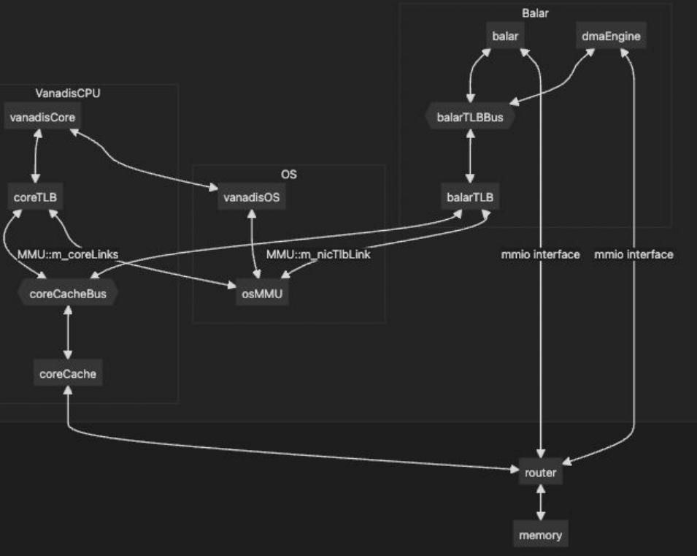
balar Integrated With vanadis via MMAP
When coupled with vanadis, RVA23+CUDA binaries can be run
Add balar as a device in VanadisOS with file descriptor being -2000 at 0x8010000
balar and the dmaEngine have both mem_iface (for data packets) and mmio_iface (for command packets)

Slide 168
Building SST with GPU Support
Requires LLVM and RISC-V gcc toolchain
https://github.com/llvm/llvm-project.git
https://github.com/riscv-collab/riscv-gnu-toolchain.git
Requires GPGPU-Sim
https://github.com/accel-sim/gpgpu-sim_distribution.git
Requires CUDA (tested with 10 and 11)
Build instructions in ../sst/elements/balar/README.md

Slide 169
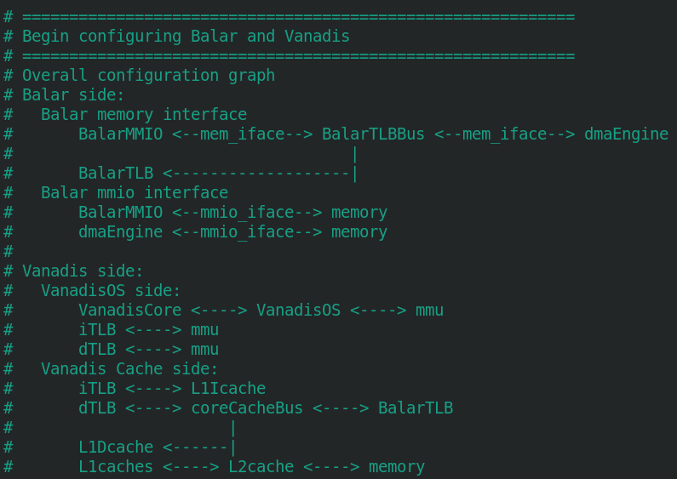
Running an Example – Hello World
Python script shows how components are connected

Slide 170
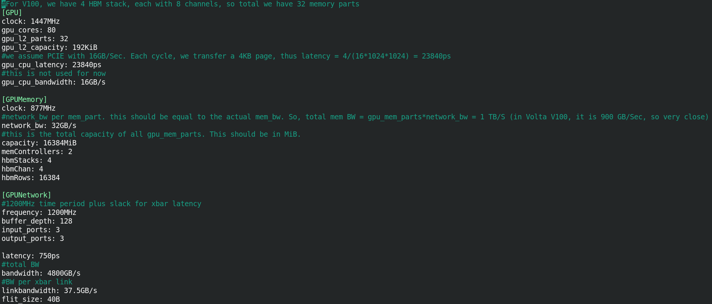
Running an Example – Hello World
GPU configuration passed in as an option to the script

Slide 171
Running an Example – Hello World
../balar/tests/testBalar-vanadis.py
VANADIS_EXE=./vanadisLLVMRISCV/vecadd VANADIS_ISA=RISCV64 BALAR_CUDA_EXE_PATH=./vanadisLLVMRISCV/vecadd sst testBalar-vanadis.py --model-options='-c gpu-v100-mem.cfg'
This runs the vector add kernel from the NVIDIA examples
The source is compiled as riscv64 target; LLVM needed for PTX but uses libraries from RISC-V gcc toolchain
Custom libcudart used to intercept CUDA APIs

Slide 172
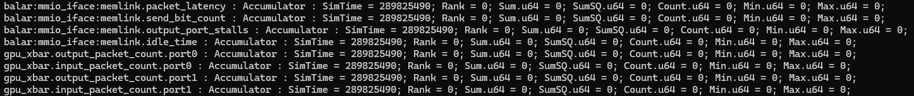
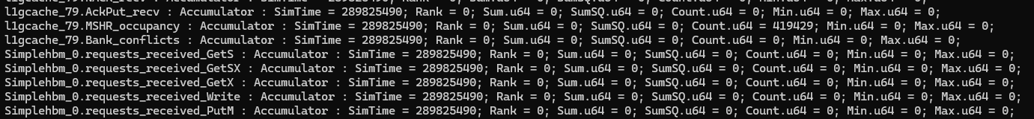
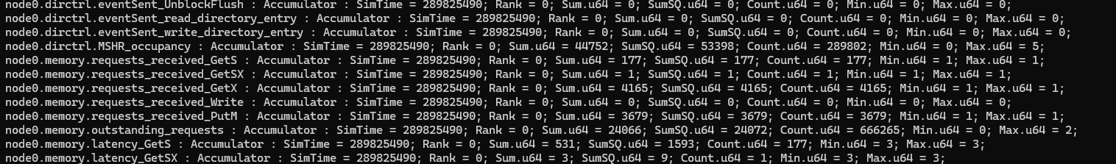
Running an Example – Hello World
Too long to run in real time (~6min)
Stats file contains 22362 unique statistics

Slide 173


Slide 174
Backup Slides

Slide 175
GPUWattch: Power model
Estimate power consumed by the GPU according to the timing behavior
Ideal for evaluating fine-grained power management mechanisms
Validated with power measurements from GV100
Modified McPAT
Modifications: Specific micro-architectural components
Interface
Interface
GPGPU-Sim
Modifications: Add required performance counters
Performance counters
Feedback-driven Optimizations
Static Power
Dynamic Power
Detailed Performance Stats
Detailed Power Stats
A Comprehensive Framework for Performance and Energy Optimization Research
Notes:
Impact statement from ASC CSSE Milestone 6812.
This is a stepping stone to achieve these goals; we still have some work to do. SST+GPU is the state-of-the-art in simulation capabilities. A literature review will reveal that, with this addition, SST provides more than other node-level simulation tool.
As we continue working on the GPU, memory, and interconnect models, we will get closer and closer to each of these impact statements.

Slide 176
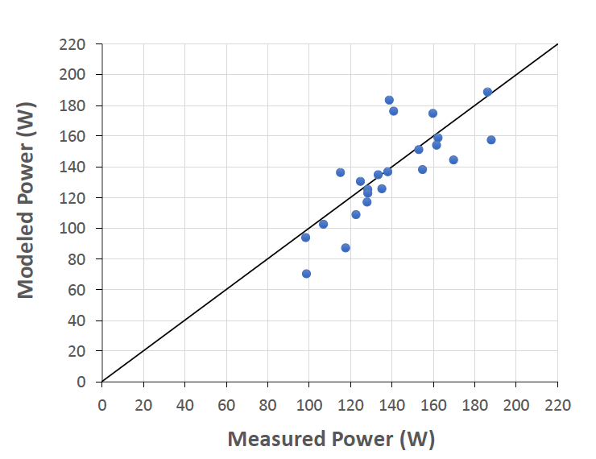
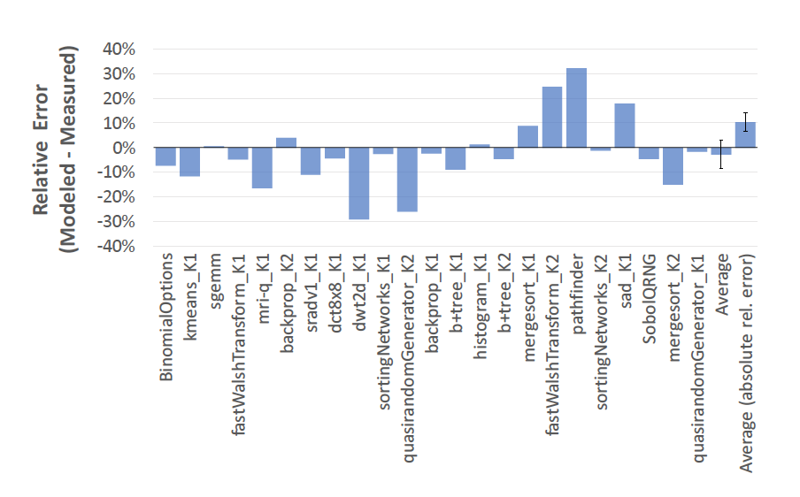
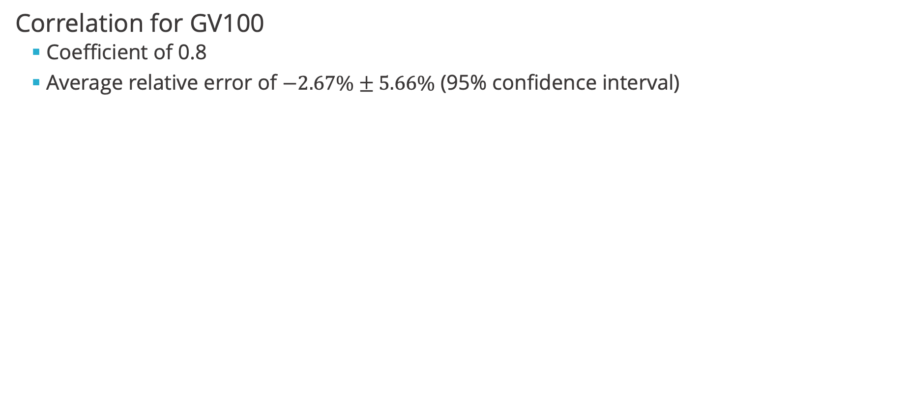
GPUWattch: Power model
Correlation for GV100
Coefficient of 0.8
Average relative error of $−2.67\%±5.66\%$ (95% confidence interval)
Notes:
Impact statement from ASC CSSE Milestone 6812.
This is a stepping stone to achieve these goals; we still have some work to do. SST+GPU is the state-of-the-art in simulation capabilities. A literature review will reveal that, with this addition, SST provides more than other node-level simulation tool.
As we continue working on the GPU, memory, and interconnect models, we will get closer and closer to each of these impact statements.

Slide 177
Outline
GPGPU-Sim Introduction
GPU and programming model
Functional model
Performance model
GPUWattch: power model
New Features in GPGPU-Sim
Volta model
Run closed source libraries
Tensor Core
Run CUTLASS library
Notes:
Description provided in ASC CSSE Milestone 6812.
Prior to this milestone, SST lacked the capability to model any external accelerator. We are now able to model a GPU accelerator in detail and analyze application and system behavior in fine detail.

Slide 178
New Feature: Volta Model Motivation
ISA cycle correlation¹ before new Volta model²
For Pascal Titan X
Benchmark | Means Abs Error |  | Correlation
 | vISA | mISA | vISA | mISA
Compute Intensive | 43.3% | 21.9% | 91.1% | 99.0%
Cache Sensitive | 104.8% | 100.4% | 81.2% | 82.0%
Memory Sensitive | 31.6% | 29.8% | 96.0% | 95.1%
Compute Balanced | 58.5% | 70.7% | 96.1% | 93.5%
Result
^{Compute intensive: mISA > vISA}
Cache sensitive: both show inaccurate cache model
Memory sensitive(streaming): not related to cache model
^{Compute balanced: vISA > mISA}
[1] Akshay Jain, Mahmoud Khairy, Timothy G. Rogers, A Quantitative Evaluation of Contemporary GPU Simulation Methodology. SIGMETRICS 2018
[2] Mahmoud Khairy, Jain Akshay, Tor Aamodt, Timothy G Rogers, Exploring Modern GPU Memory System Design Challenges through Accurate Modeling, arXiv:1810.07269
Notes:
Impact statement from ASC CSSE Milestone 6812.
This is a stepping stone to achieve these goals; we still have some work to do. SST+GPU is the state-of-the-art in simulation capabilities. A literature review will reveal that, with this addition, SST provides more than other node-level simulation tool.
As we continue working on the GPU, memory, and interconnect models, we will get closer and closer to each of these impact statements.

Slide 179
New features: Volta model¹
Fermi-based Model
SIMT Core
Memory Hierarchy
Warp
Scheduler
Exec Units
L1D cache/Shared Memory
Programmable-specified cache
L2 cache
Register File
(16 banks)
GDDR5 Model
SP
Instruction Cache
SP
Fermi coalescer
Warp
Scheduler
SFU
[1] Mahmoud Khairy, Jain Akshay, Tor Aamodt, Timothy G Rogers, Exploring Modern GPU Memory System Design Challenges through Accurate Modeling, arXiv:1810.07269
Notes:
Impact statement from ASC CSSE Milestone 6812.
This is a stepping stone to achieve these goals; we still have some work to do. SST+GPU is the state-of-the-art in simulation capabilities. A literature review will reveal that, with this addition, SST provides more than other node-level simulation tool.
As we continue working on the GPU, memory, and interconnect models, we will get closer and closer to each of these impact statements.

Slide 180
New features: Volta model¹
Volta-based Model
disaggregate RF
(2 banks)
Subcore model
+DP, INT, Tensor
SIMT Core
Memory Hierarchy
High-bandwidth Memory
Warp
Scheduler
Register File
SP
DP
SFU
INT
Tensor
Exec Units
Warp
Scheduler
Register File
SP
DP
SFU
INT
Tensor
Exec Units
L2 Cache
+Sectored, +memory copy engine model
+New Lazy_Fetch_on_Read write policy,
+partition-camping-aware hashing
L1D Cache / Shared Memory
+Sectored, +Adaptive cache (128 KB),
+Streaming cache +Banked
HBM
+ HBM Model, +dual-bus interface
+ Read/Write buffers
Volta coalescer (8 threads coalescer)
Instruction Cache
Warp
Scheduler
Register File
SP
DP
SFU
INT
Tensor
Exec Units
Warp
Scheduler
Register File
SP
DP
SFU
INT
Tensor
Exec Units
[1] Mahmoud Khairy, Jain Akshay, Tor Aamodt, Timothy G Rogers, Exploring Modern GPU Memory System Design Challenges through Accurate Modeling, arXiv:1810.07269
Notes:
Impact statement from ASC CSSE Milestone 6812.
This is a stepping stone to achieve these goals; we still have some work to do. SST+GPU is the state-of-the-art in simulation capabilities. A literature review will reveal that, with this addition, SST provides more than other node-level simulation tool.
As we continue working on the GPU, memory, and interconnect models, we will get closer and closer to each of these impact statements.

Slide 181
Hardware correlation for Volta model¹
Statistic | Means Abs Error |  | Correlation
 | Old Model | New Model | Old Model | New Model
Execution Cycles | 68% | 27% | 71% | 96%
L1 Reqs | 48% | 0.5% | 92% | 100%
L1 Hit Ratio | 41% | 18% | 89% | 93%
L2 Reads | 66% | 1% | 49% | 94%
L2 Writes | 56% | 1% | 99% | 100%
L2 Read Hits | 80% | 15% | 68% | 81%
DRAM Reads | 89% | 11% | 60% | 95%
2.5X error reduction
in exec time
0.5% error in L1 reqs
(96x reqs error reduction)
SIMT Core
Memory Hierarchy
1% error in L2 behavior
(66x read error reduction)
7X error reduction
in DRAM reads
[1] Mahmoud Khairy, Jain Akshay, Tor Aamodt, Timothy G Rogers, Exploring Modern GPU Memory System Design Challenges through Accurate Modeling, arXiv:1810.07269
Notes:
Impact statement from ASC CSSE Milestone 6812.
This is a stepping stone to achieve these goals; we still have some work to do. SST+GPU is the state-of-the-art in simulation capabilities. A literature review will reveal that, with this addition, SST provides more than other node-level simulation tool.
As we continue working on the GPU, memory, and interconnect models, we will get closer and closer to each of these impact statements.

Slide 182
Run closed source model¹
Run applications with cuDNN/cuBLAS
Static linking closed source libraries
LeNet for MNIST using cuDNN/cuBLAS
CUDA API layer
Executable
GPGPU-Sim
CUDA runtime API layer
Application
CUDA runtime API
Performance model
static cuDNN library
CUDA runtime API
static cuBLAS library
Functional model
[1] Jonathan Lew, Deval Shah, Suchita Pati, Shaylin Cattell, Mengchi Zhang, Amruth Sandhupatla, Christopher Ng, Negar Goli, Matthew D. Sinclair, Timothy G. Rogers, Tor M. Aamodt Analyzing Machine Learning Workloads Using a Detailed GPU Simulator, arXiv:1811.08933
Notes:
Impact statement from ASC CSSE Milestone 6812.
This is a stepping stone to achieve these goals; we still have some work to do. SST+GPU is the state-of-the-art in simulation capabilities. A literature review will reveal that, with this addition, SST provides more than other node-level simulation tool.
As we continue working on the GPU, memory, and interconnect models, we will get closer and closer to each of these impact statements.

Slide 183
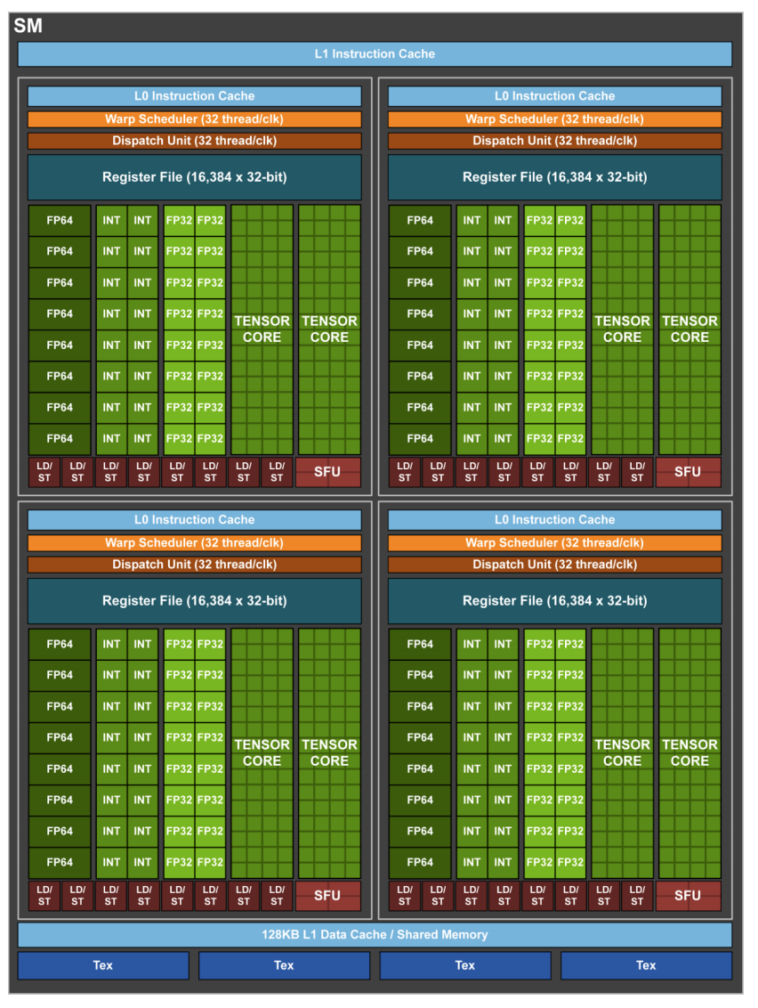
Tensor Core in GV100
Accelerate FP operations
8 Tensor Core/SM
Each perform 64 FP FMA/clock
512 FMA/clock/SM
Or 1024 FP ops/clock/SM
Notes:
Impact statement from ASC CSSE Milestone 6812.
This is a stepping stone to achieve these goals; we still have some work to do. SST+GPU is the state-of-the-art in simulation capabilities. A literature review will reveal that, with this addition, SST provides more than other node-level simulation tool.
As we continue working on the GPU, memory, and interconnect models, we will get closer and closer to each of these impact statements.

Slide 184
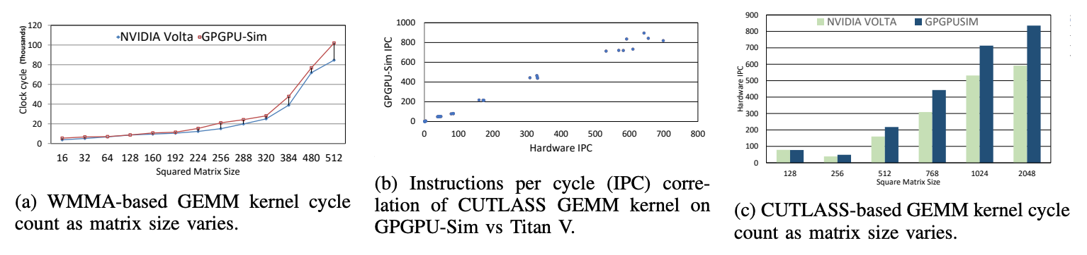
Tensor Core in Tesla Titan V¹
Standard deviation of less than 5%
99.60% IPC correlation
GPGPU-Sim shows higher perf than HW as matrix size increase
[1] Md Aamir Raihan, Negar Goli, Tor Aamodt, Modeling Deep Learning Accelerator Enabled GPUs, ISPASS 2019
Notes:
Impact statement from ASC CSSE Milestone 6812.
This is a stepping stone to achieve these goals; we still have some work to do. SST+GPU is the state-of-the-art in simulation capabilities. A literature review will reveal that, with this addition, SST provides more than other node-level simulation tool.
As we continue working on the GPU, memory, and interconnect models, we will get closer and closer to each of these impact statements.

Slide 185
Run CUTLASS library
Combine CUTLASS, tensor core¹, and volta model²
Correlation: using Deepbench training/inference test from real scenario
[1] Md Aamir Raihan, Negar Goli, Tor Aamodt, Modeling Deep Learning Accelerator Enabled GPUs, ISPASS 2019
[2] Mahmoud Khairy, Jain Akshay, Tor Aamodt, Timothy G Rogers, Exploring Modern GPU Memory System Design Challenges through Accurate Modeling, arXiv:1810.07269
Notes:
Impact statement from ASC CSSE Milestone 6812.
This is a stepping stone to achieve these goals; we still have some work to do. SST+GPU is the state-of-the-art in simulation capabilities. A literature review will reveal that, with this addition, SST provides more than other node-level simulation tool.
As we continue working on the GPU, memory, and interconnect models, we will get closer and closer to each of these impact statements.

Slide 186
GPGPU-Sim Introduction
GPGPU-Sim simulates kernel
Transfer data to GPU memory
GPU kernels runs on GPGPU-Sim:
Reports statistics for the kernels
Transfer data back to CPU memory
CPU
Async. Kernel Launch
GPU HW
GPGPU-Sim
Done
GPU HW
GPGPU-Sim
Blocking
Done
CPU
Sync. Kernel Launch
GPU HW
GPGPU-Sim
Done
CPU
Time
Notes:
Impact statement from ASC CSSE Milestone 6812.
This is a stepping stone to achieve these goals; we still have some work to do. SST+GPU is the state-of-the-art in simulation capabilities. A literature review will reveal that, with this addition, SST provides more than other node-level simulation tool.
As we continue working on the GPU, memory, and interconnect models, we will get closer and closer to each of these impact statements.

Slide 187
Functional model
Single Instruction Multiple Thread(SIMT):
SIMD + multithreading
Grid, Block, Warp, Thread
Virtual ISA vs. Machine ISA
vISA: PTX = Parallel Thread eXecution: virtual ISA defined by Nvidia
mISA: SASS = Native ISA for Nvidia GPUs
GPGPU-Sim use PTXPlus to represent SASS
1:1 mapping from SASS to PTXPlus
GPGPU-Sim supports:
PTX for new architectures(CUDA 10): new, inaccurate, well documented
SASS for architecture before Fermi(SM_1.X): old, accurate, less documented

Slide 188
Performance model
GPGPU-Sim models timing
SIMT Core
Caches and texture/constant/shared memory
Interconnection network(Booksim)
DRAM(GDDR5/HBM)
DO NOT model
Graphic Specific Hardware

Slide 189

BalarMMIO
Responsible for relaying CUDA api requests from SST to GPGPU-Sim.
Currently it supports running with CUDA traces without a real CPU model (with BalarTestCPU) or with Vanadis core
Notes:
onWrite: Upon a write request, BalarMMIO record the data of the write request payload as the address to read CUDA api call packet
Read_cuda_packet: BalarMMIO reads the CUDA packet from SST memory space
onReadResp of this request, if api is not memcpyH2D, the api is considered called and Balar will wait for next API or memcpyD2H to finish
if the api is memcpyH2D and SST memory is set, Balar will call DMA to perform data movement before actually launching the cudaMemcpyH2D call.
onSST_callback_memcpy_D2H_done:
This event occurs when the callback function `SST_callback_memcpy_D2H_done` is called, signaling GPGPU-Sim has finished copying data into its simulated GPU memory (functional model).
Will create a `Issue_DMA_memcpy_D2H` packet with SST memory
Issue_DMA_memcpy_D2H: instruct DMA engine to copy data from device (simulator mem space) to host (Vanadis, SST mem space)
onRead: upon a read request, BalarMMIO starts writing return packet to the address passed on the previous onWrite.

Slide 190
Slide Left Blank

